Slide 1
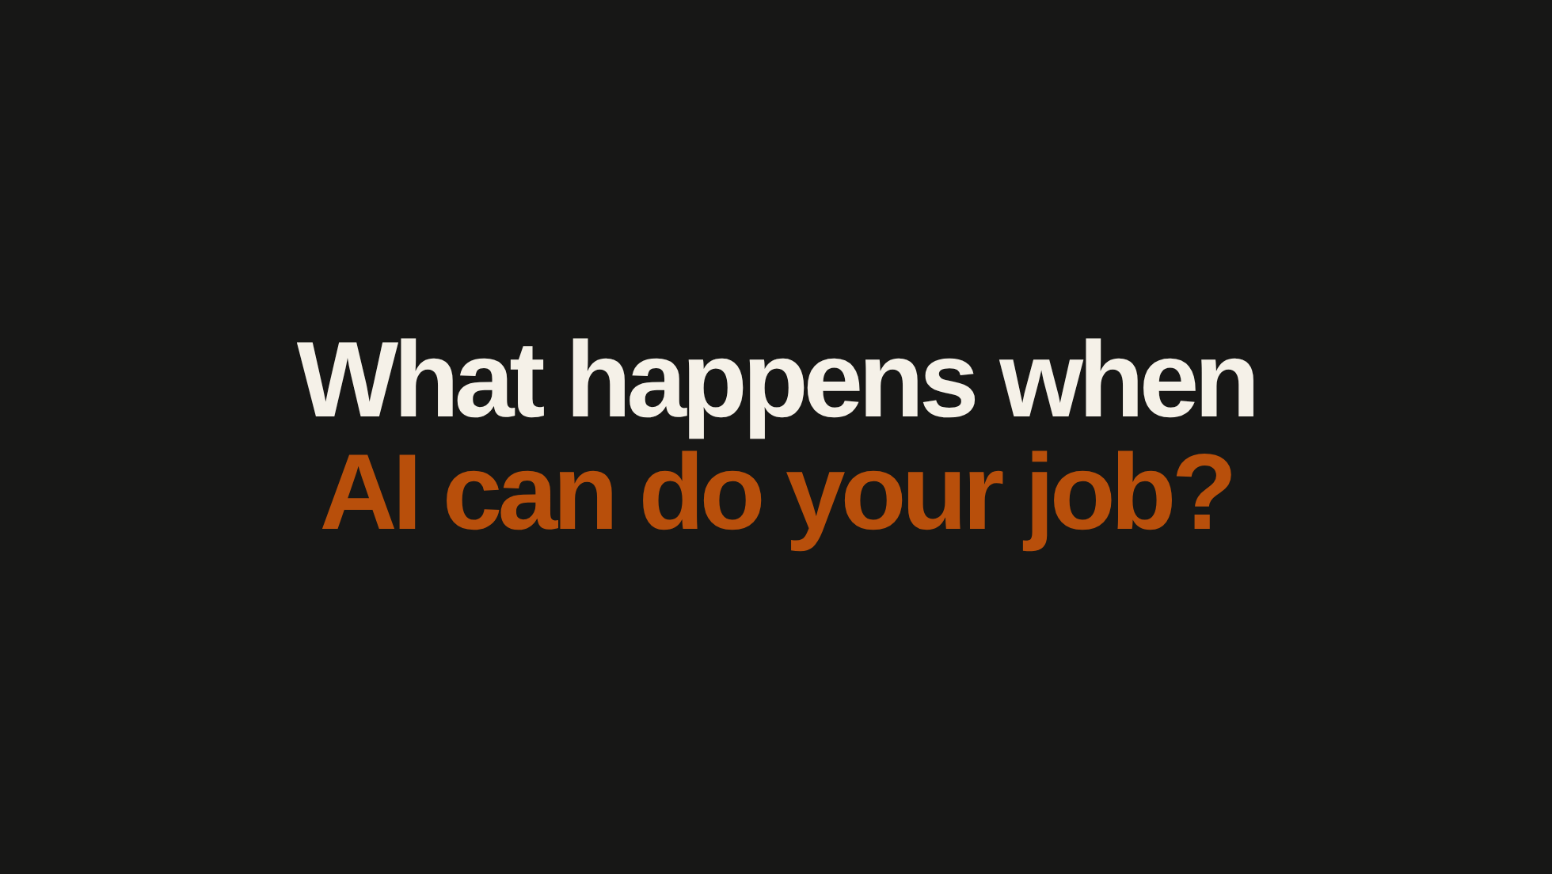

Slide 2
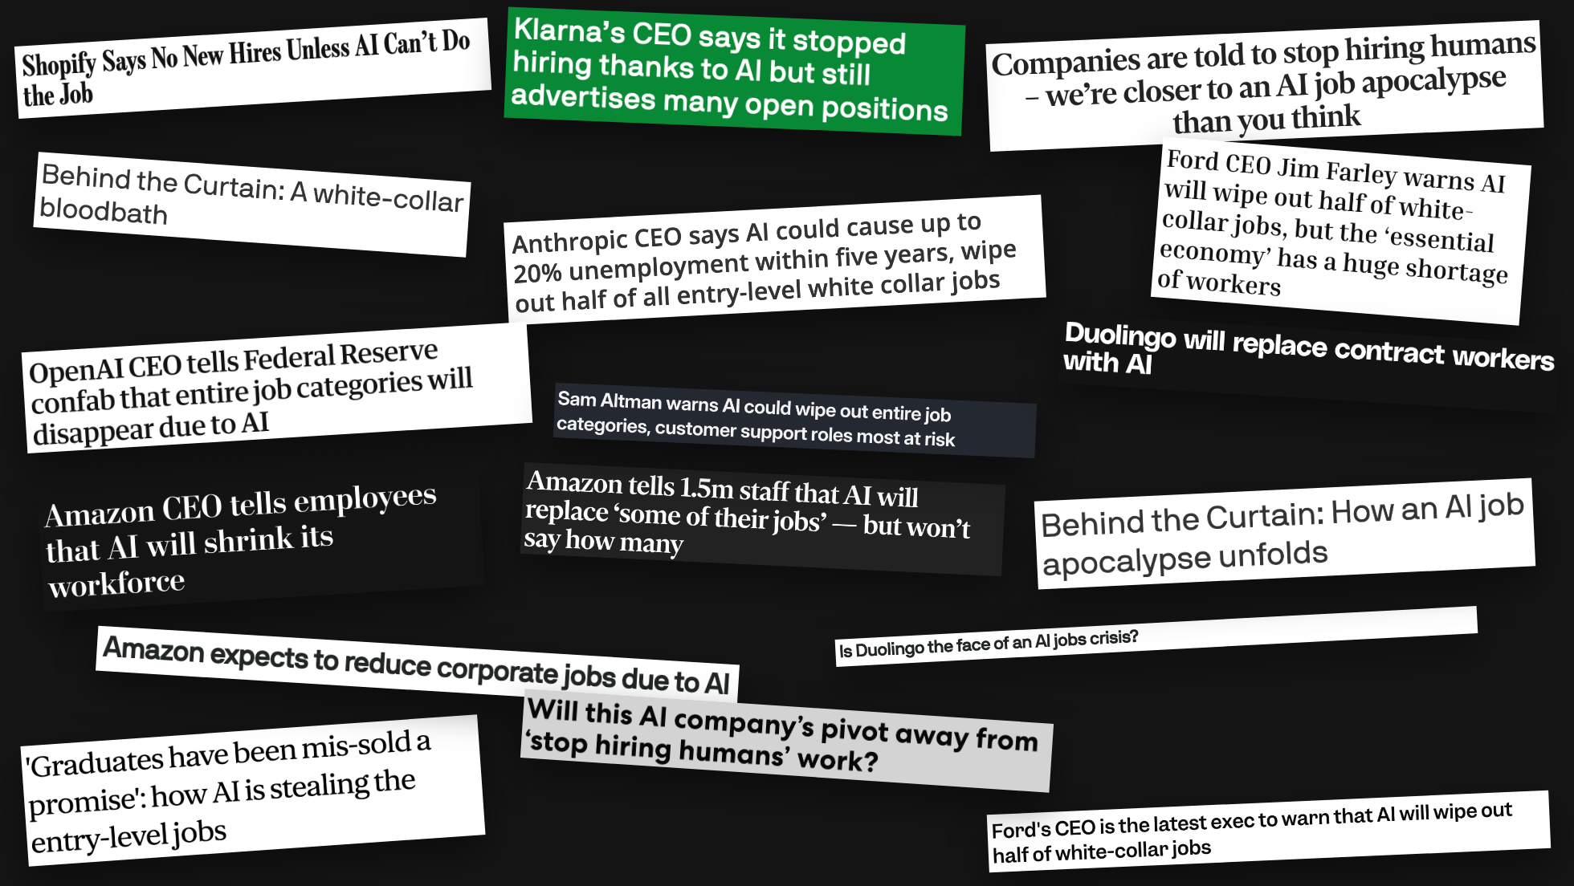
Notes:
[Sources]
- User-provided article URLs, captured as title-only images in assets/headlines/ on 2026-08-28.
[/Sources]

Slide 3
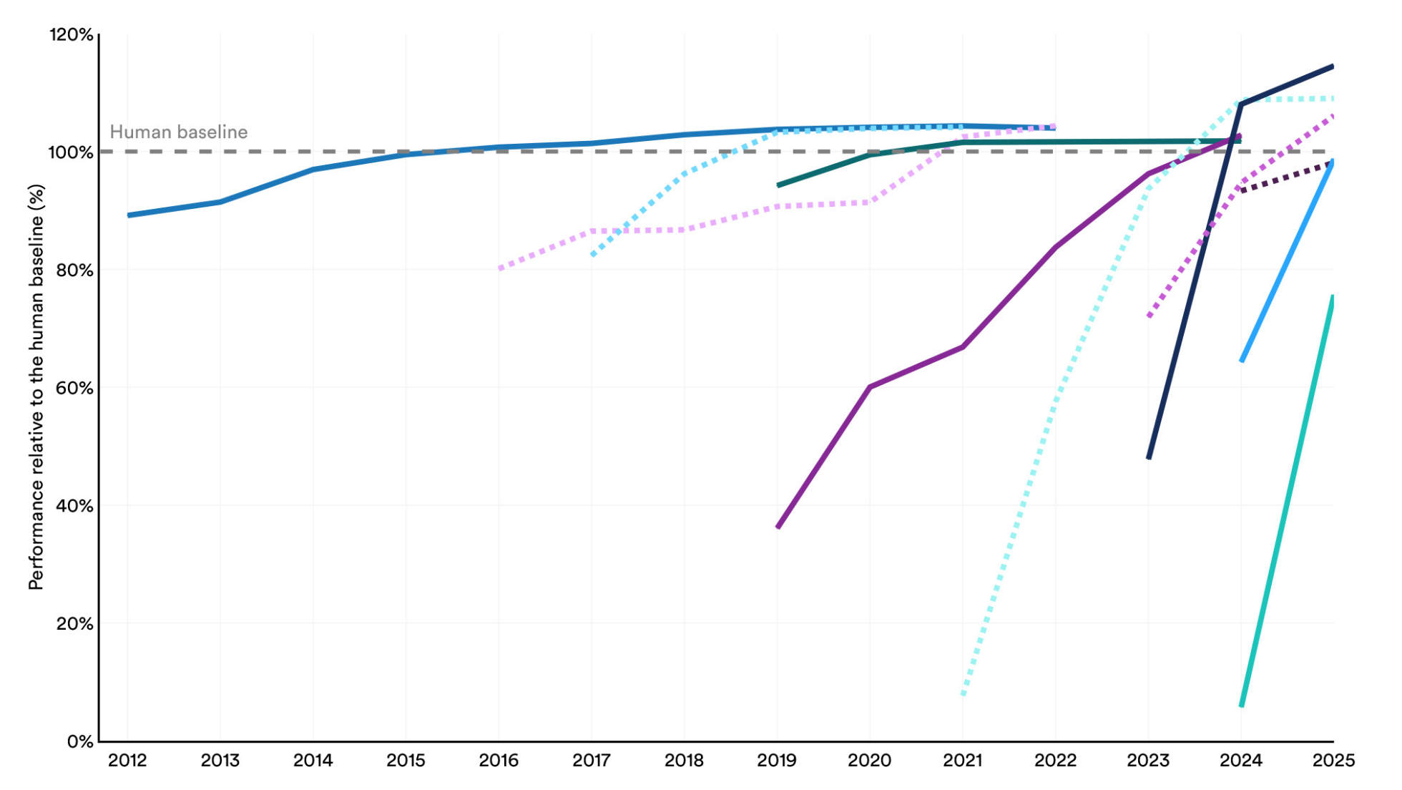
Notes:
[Sources]
- Stanford HAI, 2026 AI Index Report, Technical Performance, figure 2.1.1, “Select AI Index technical performance benchmarks vs. human performance”: https://hai.stanford.edu/ai-index/2026-ai-index-report/technical-performance
- Original 2024 × 1505 JPEG, downloaded unmodified on 2026-10-20: https://hai.stanford.edu/assets/images/fig_211.jpg
- User-requested display crop, 2026-10-30: hide the heading, source line and bottom colour legend; retain the axes, percentages, years and complete plotted data. The original file and the following zoomed views are unchanged.
- © Stanford University. No chart-specific open reuse licence identified; user-requested reproduction from the publisher. General site terms: https://www.stanford.edu/terms
[/Sources]

Slide 4
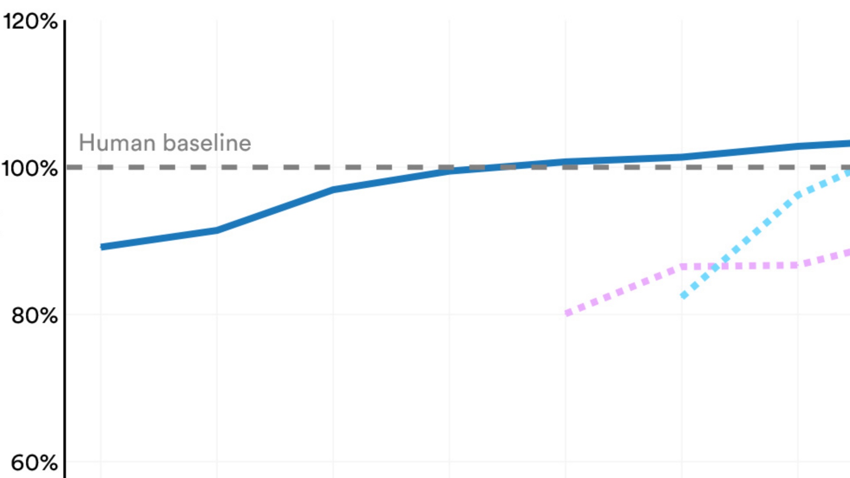
Notes:
[Sources]
- Zoomed view of the same unmodified Stanford HAI 2026 AI Index chart on the preceding slide, figure 2.1.1: https://hai.stanford.edu/ai-index/2026-ai-index-report/technical-performance
- Original 2024 × 1505 JPEG: https://hai.stanford.edu/assets/images/fig_211.jpg
- © Stanford University. No chart-specific open reuse licence identified; user-requested reproduction from the publisher. General site terms: https://www.stanford.edu/terms
[/Sources]

Slide 5
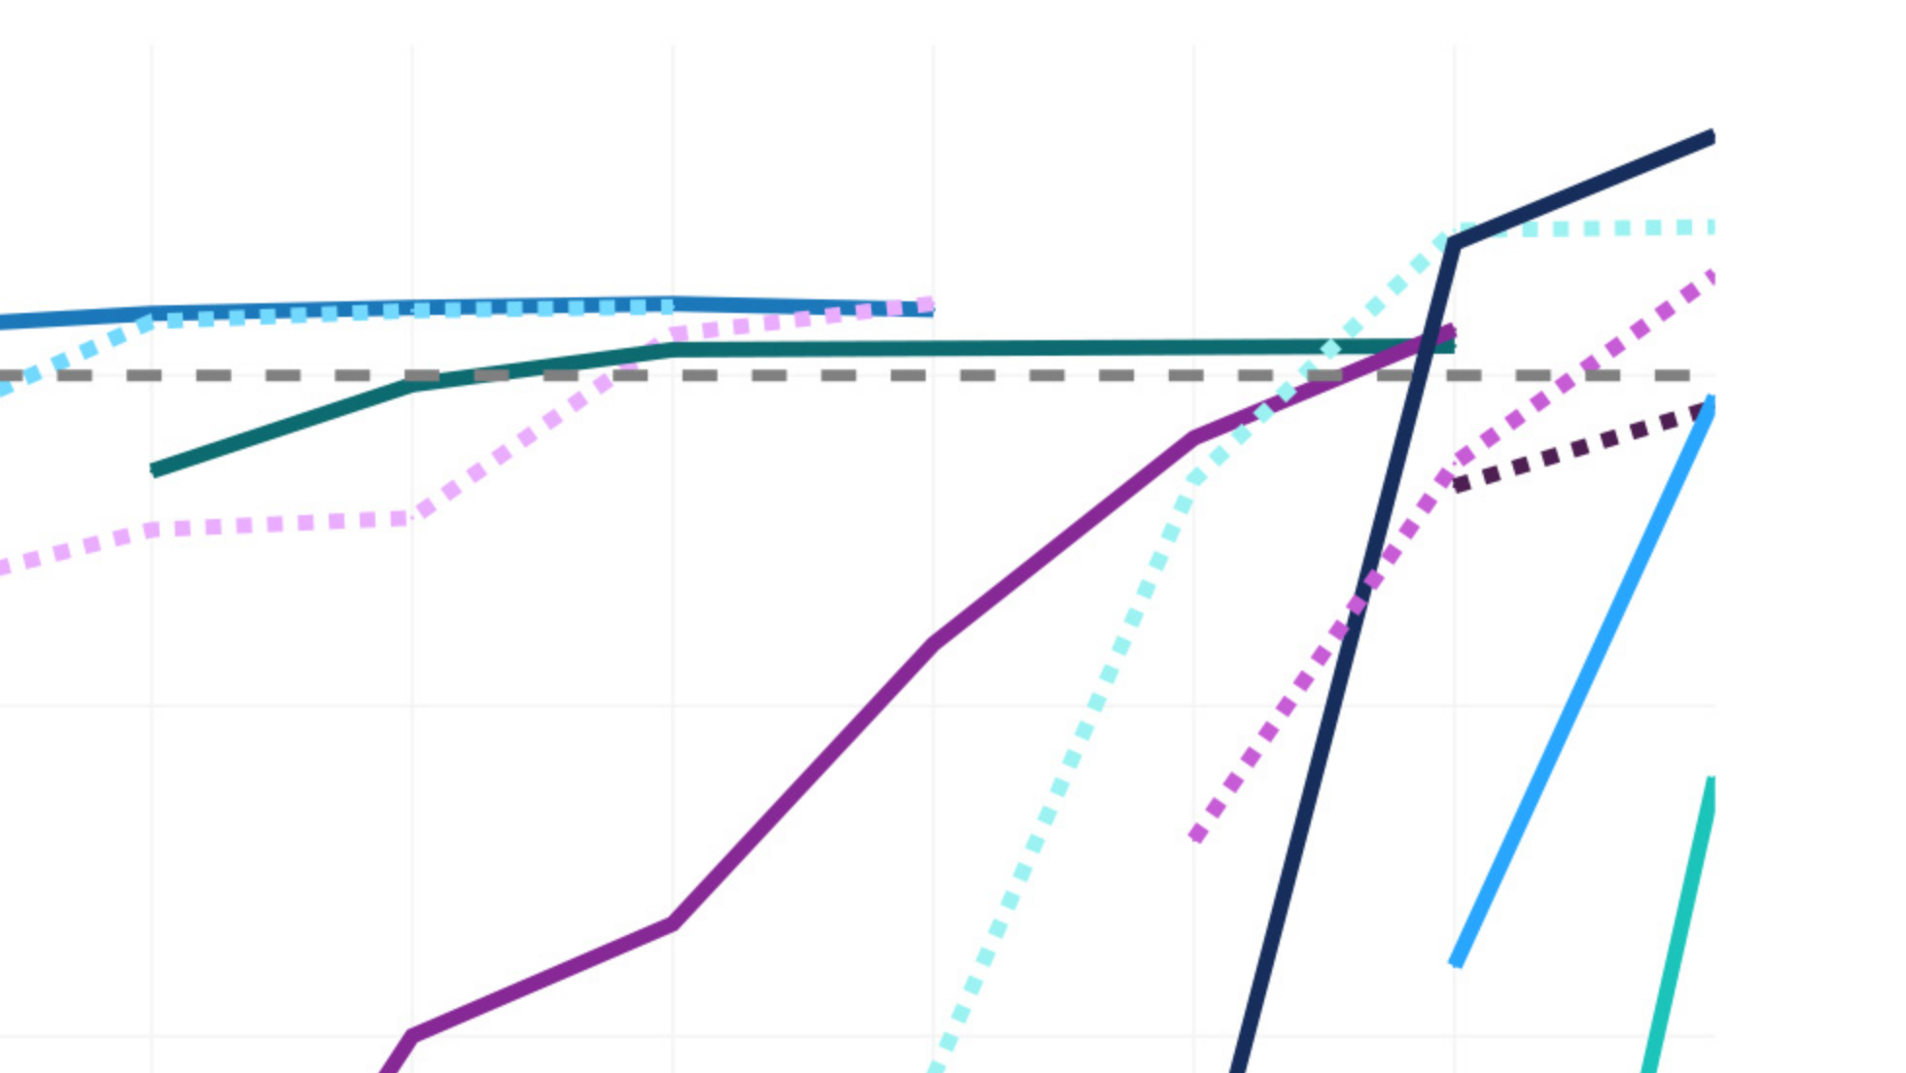
Notes:
[Sources]
- Zoomed view of the same unmodified Stanford HAI 2026 AI Index chart, figure 2.1.1: https://hai.stanford.edu/ai-index/2026-ai-index-report/technical-performance
- Original 2024 × 1505 JPEG: https://hai.stanford.edu/assets/images/fig_211.jpg
- © Stanford University. No chart-specific open reuse licence identified; user-requested reproduction from the publisher. General site terms: https://www.stanford.edu/terms
[/Sources]

Slide 6
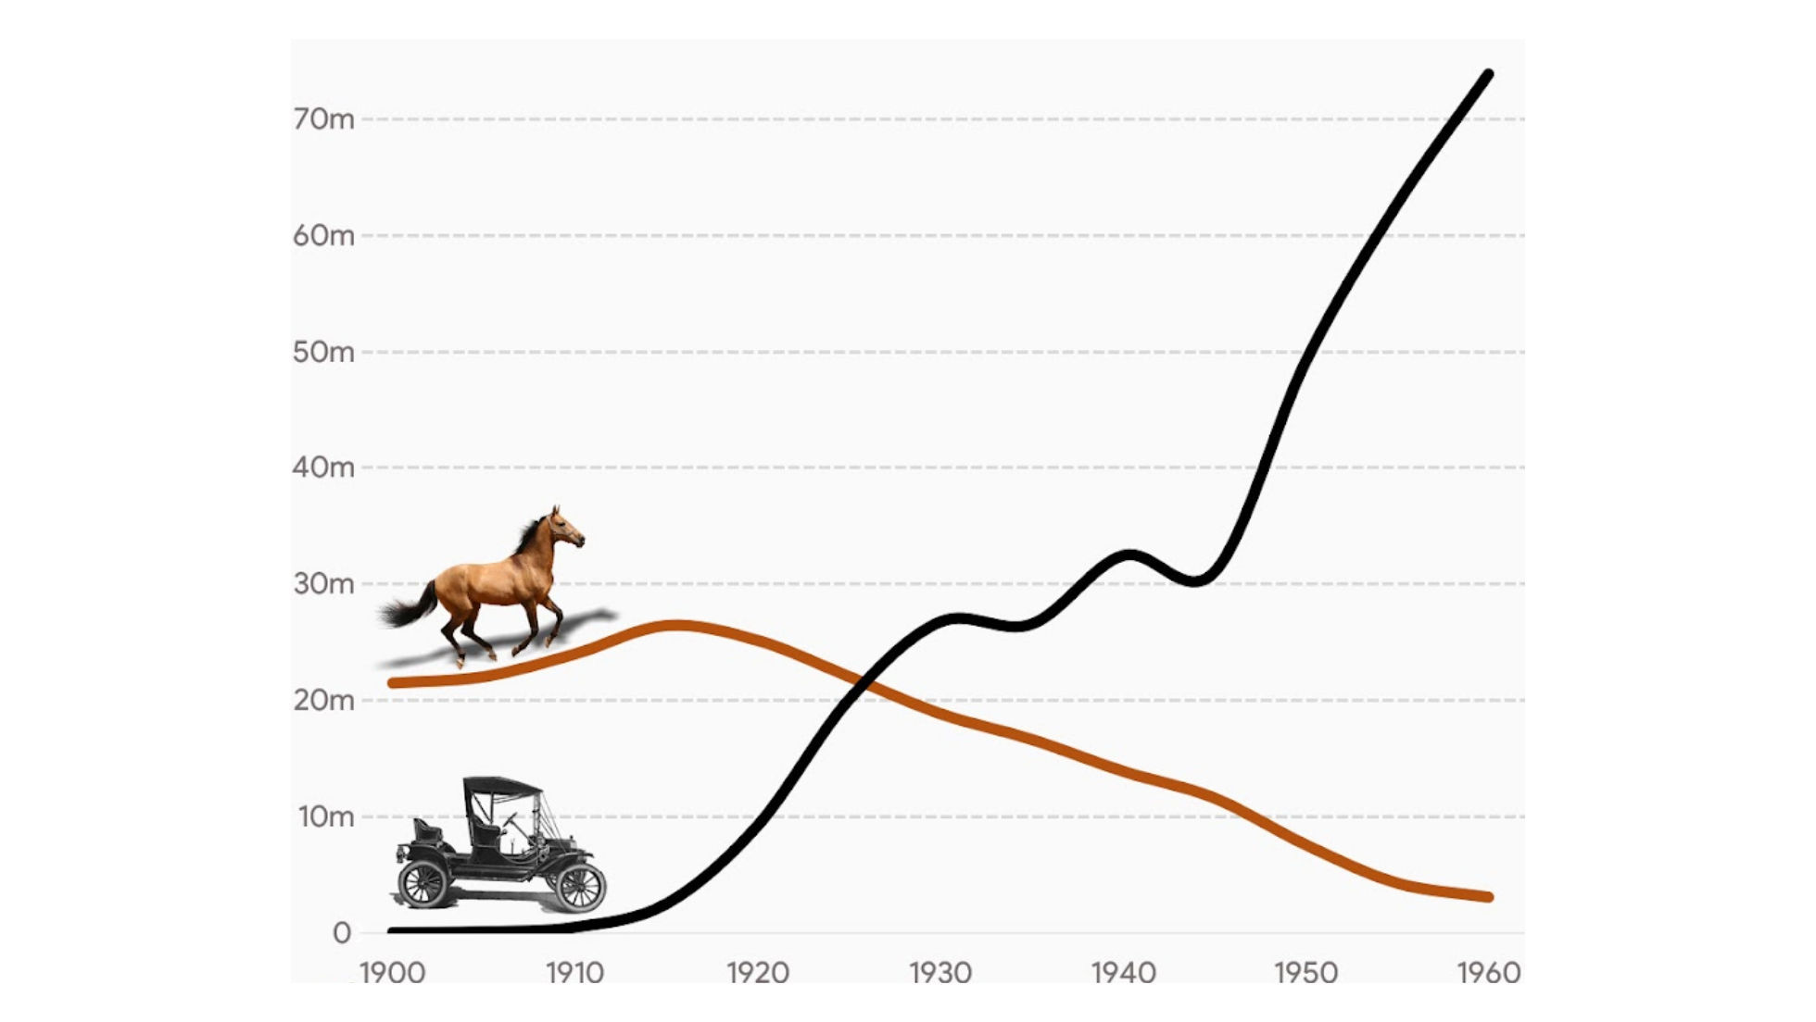
Notes:
[Sources]
- StaDaFa.com chart; underlying data sources are credited within the image.
- User-requested display crop, 2026-10-30: hide the heading and source footer, retaining the axes, values, years and plotted data. The complete original file, including its attribution, is retained unchanged.
[/Sources]

Slide 7
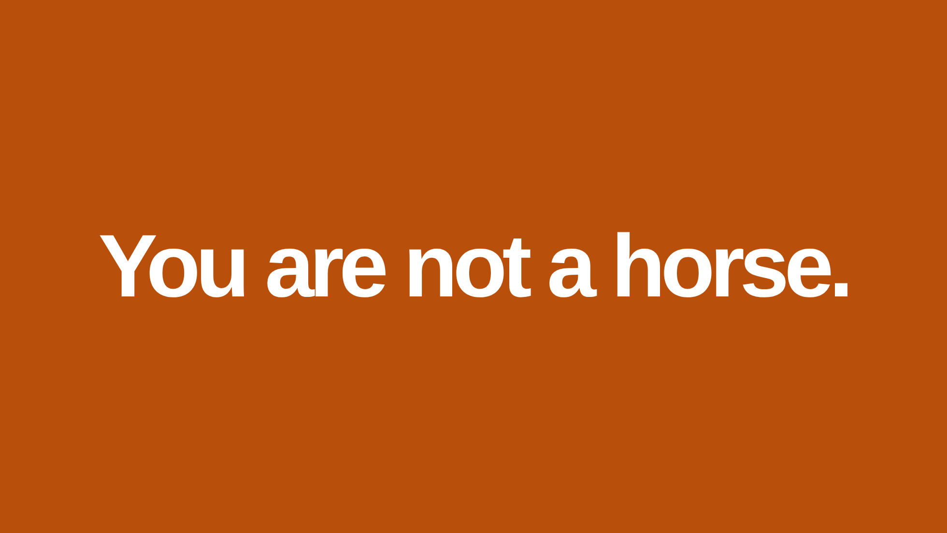

Slide 8
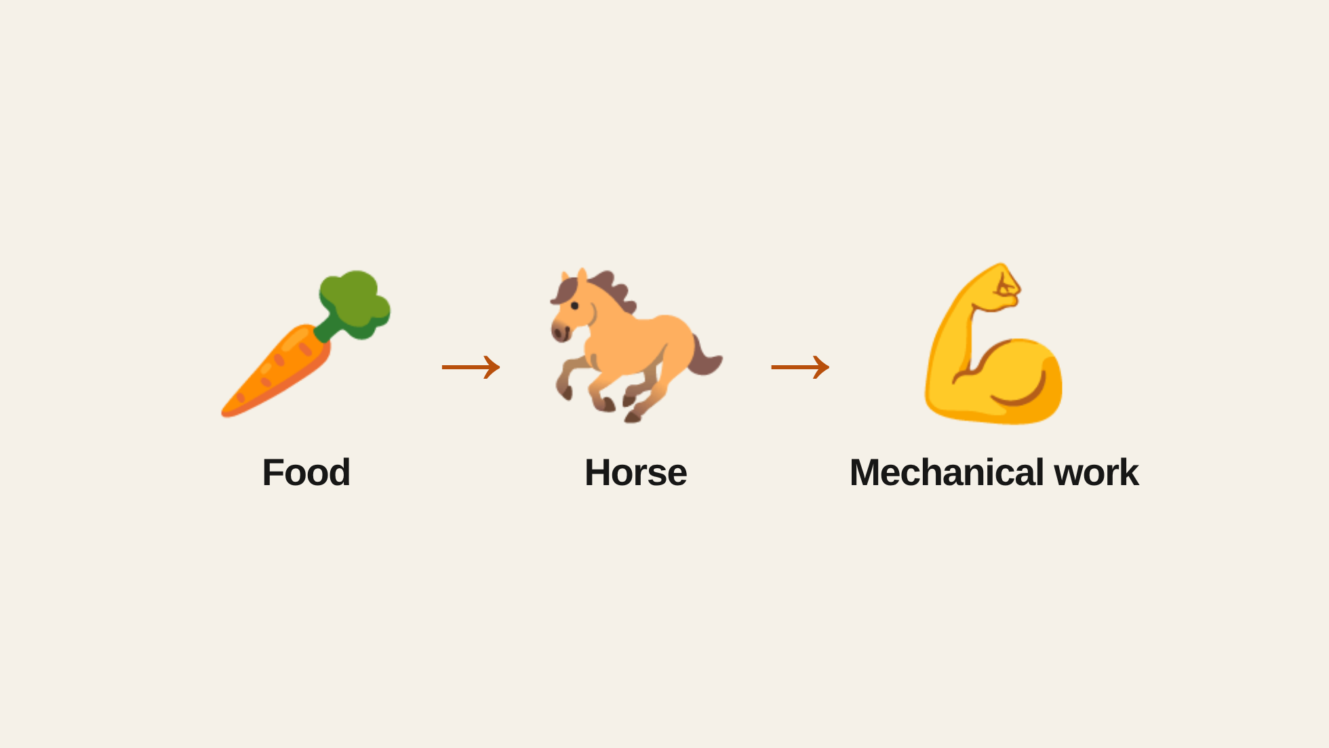

Slide 9
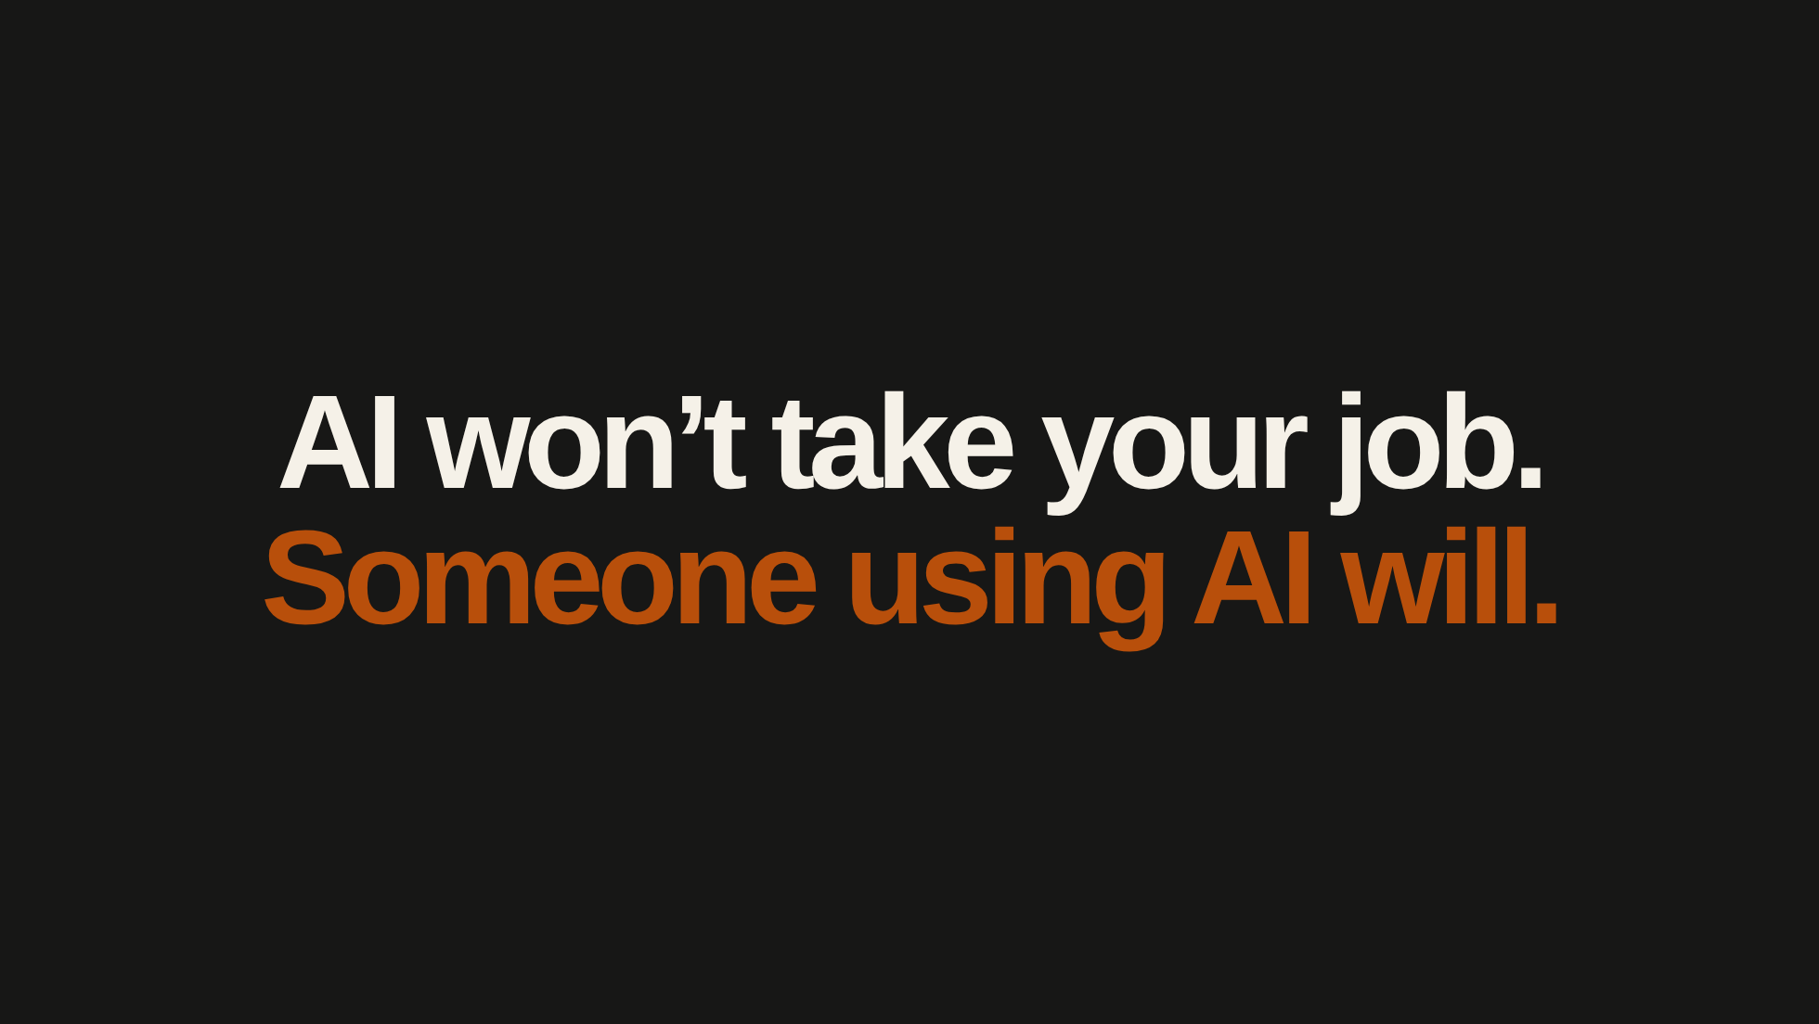

Slide 10
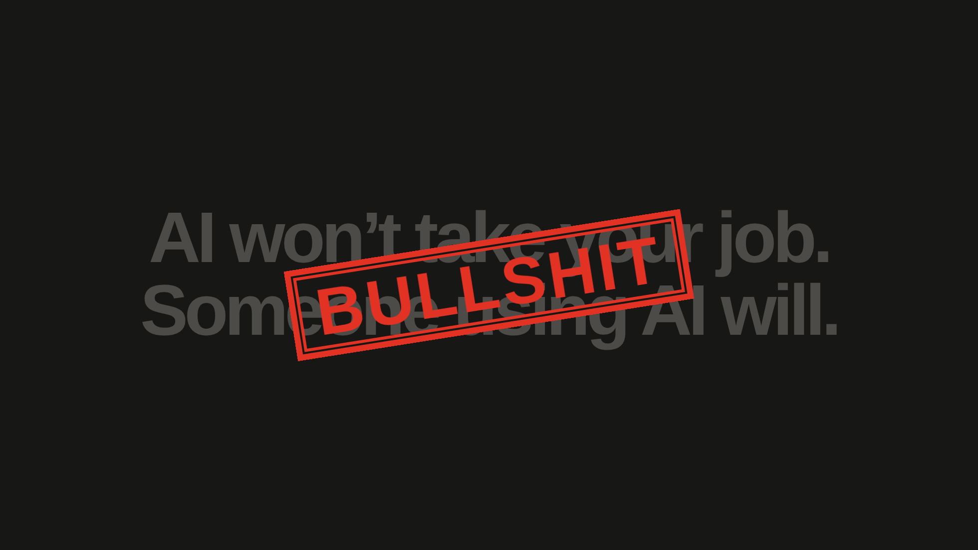

Slide 11
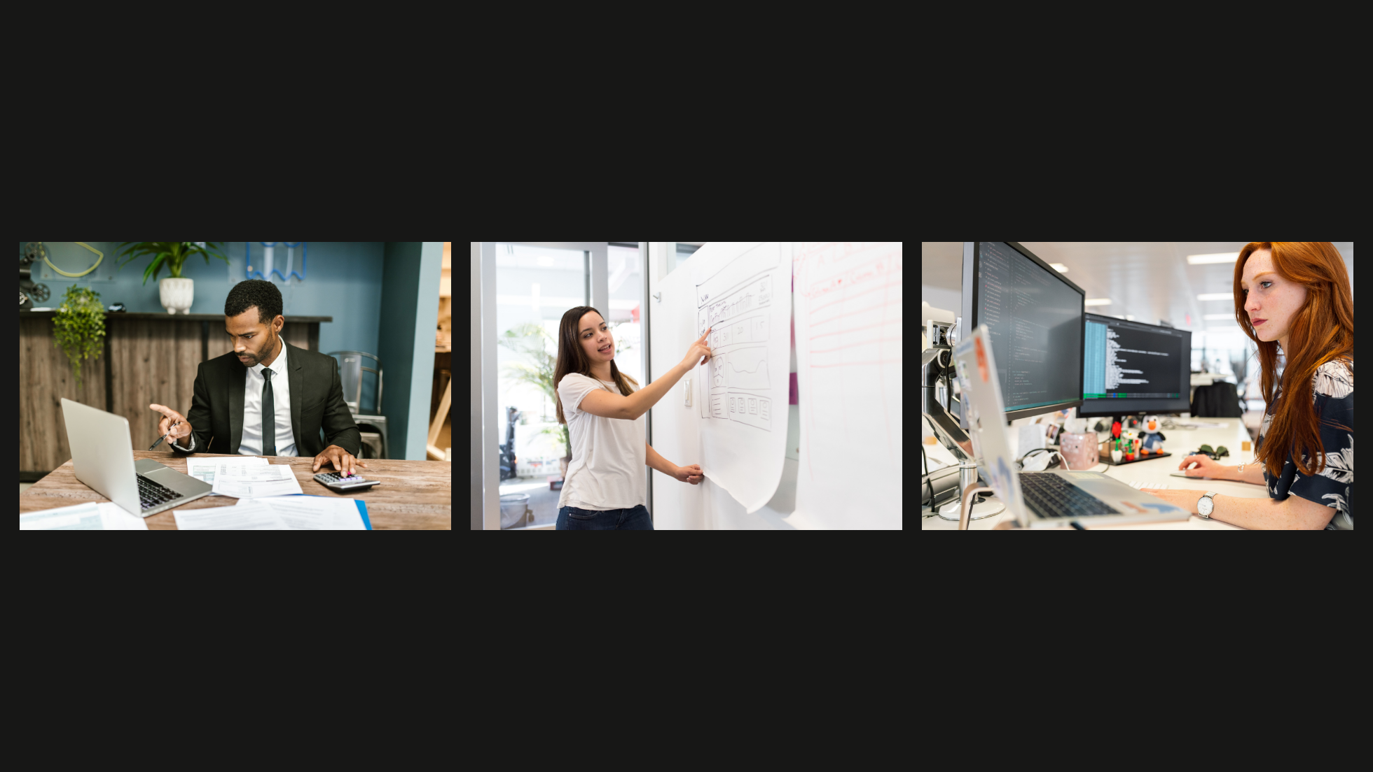
Notes:
[Sources]
- RDNE Stock project on Pexels: https://www.pexels.com/photo/a-man-sitting-at-the-table-7821715/
- Christina Morillo on Pexels: https://www.pexels.com/photo/photo-of-woman-pointing-on-white-paper-1181487/
- ThisIsEngineering on Pexels: https://www.pexels.com/photo/woman-coding-on-computer-3861958/
[/Sources]

Slide 12
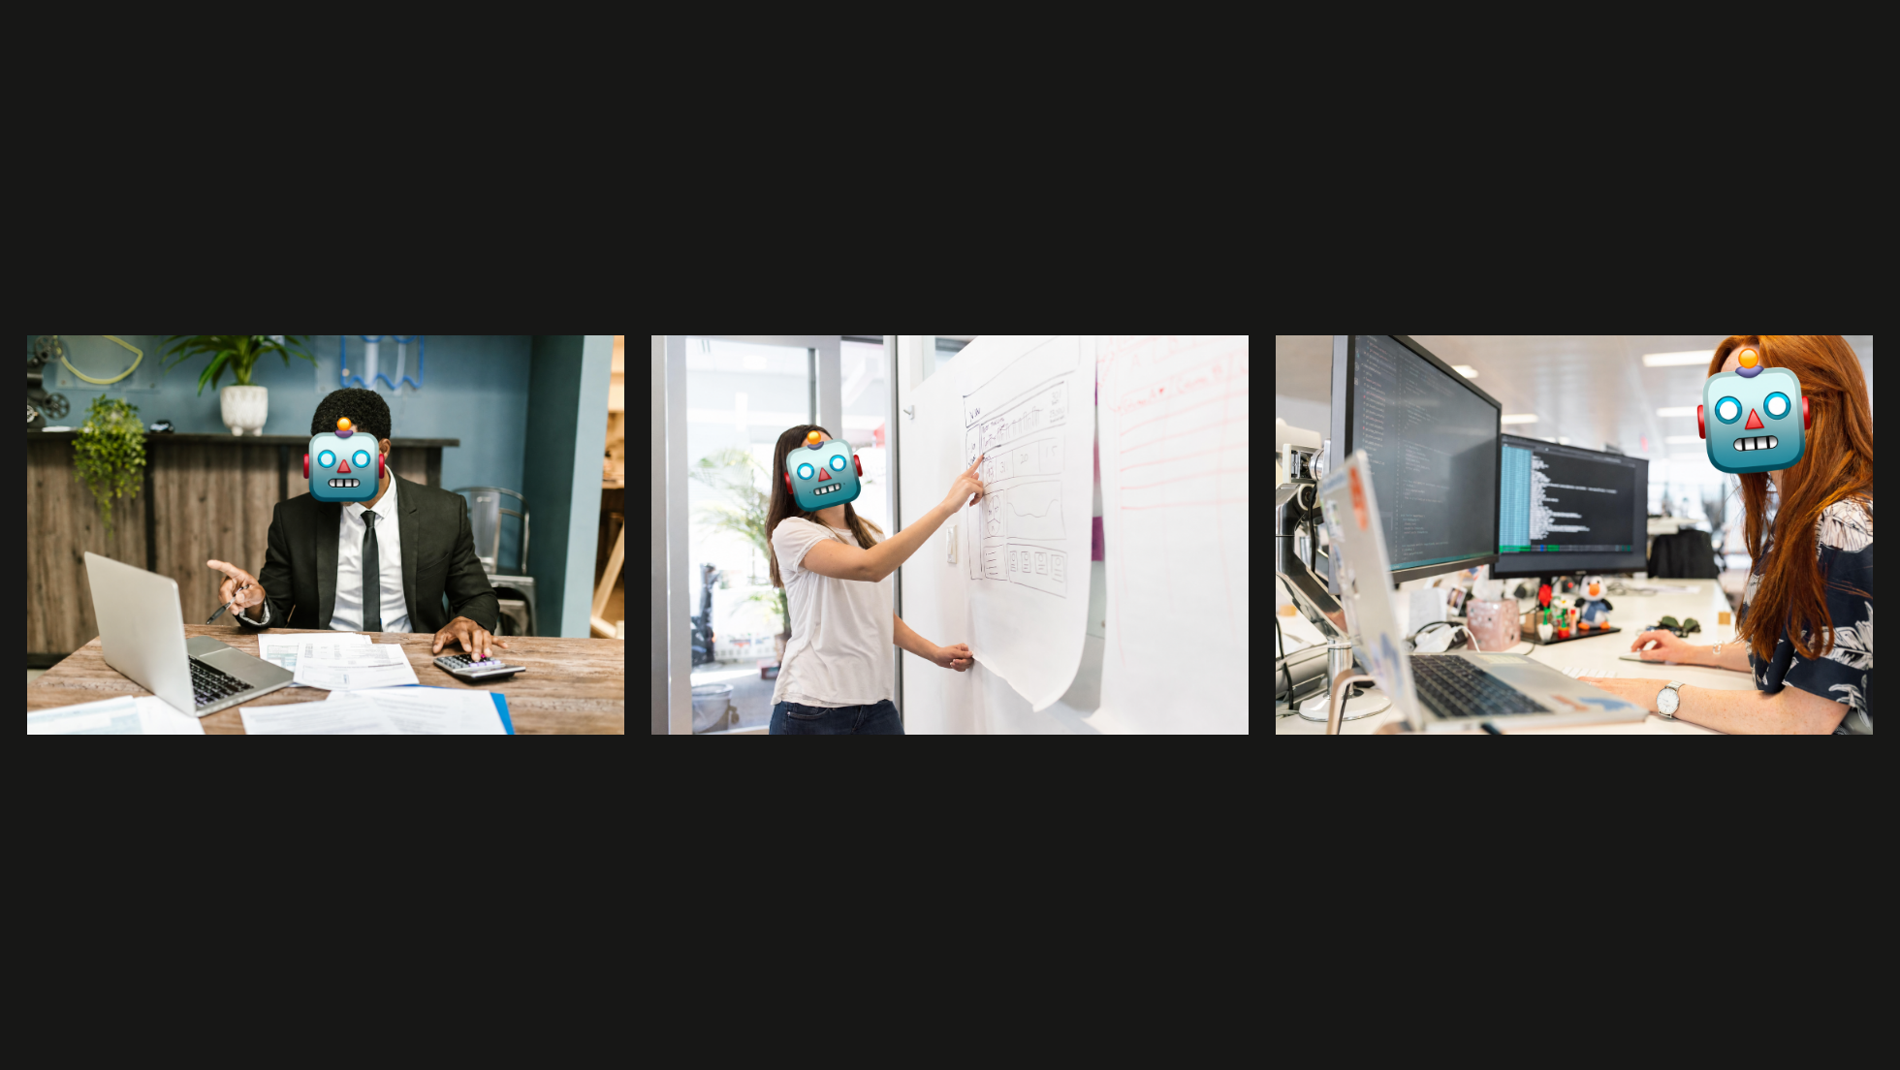
Notes:
[Sources]
- Derived from the preceding Pexels photographs with robot-face overlays generated using OpenAI image generation.
[/Sources]

Slide 13
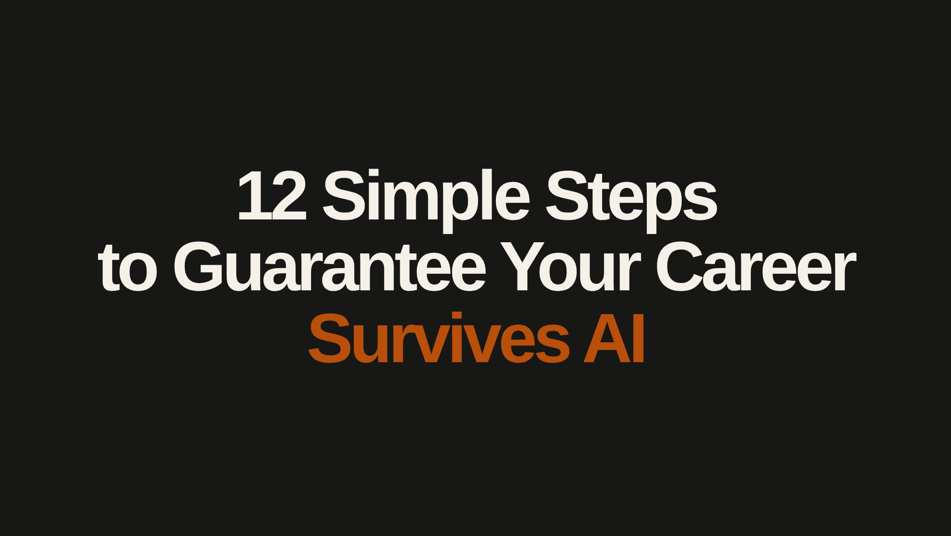

Slide 14
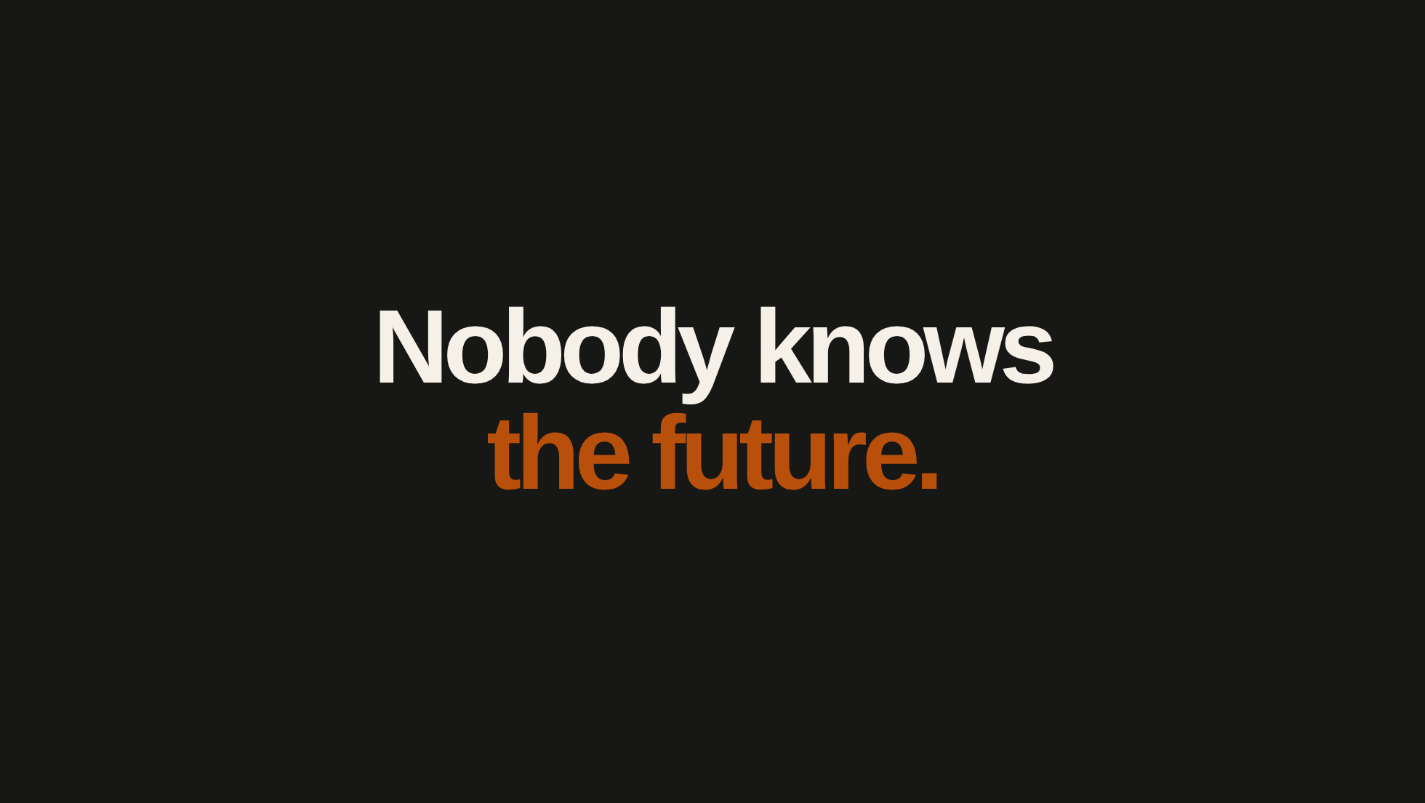

Slide 15
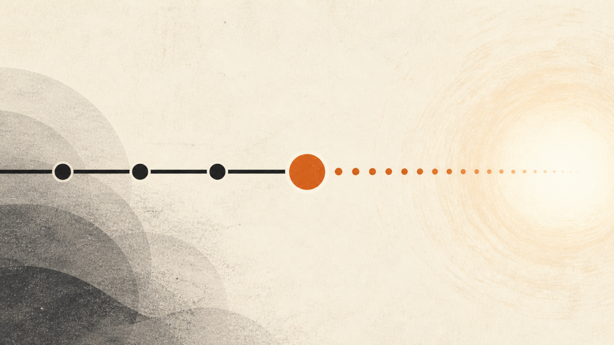
Notes:
[Sources]
- Original illustration generated for this presentation with OpenAI image generation.
[/Sources]

Slide 16
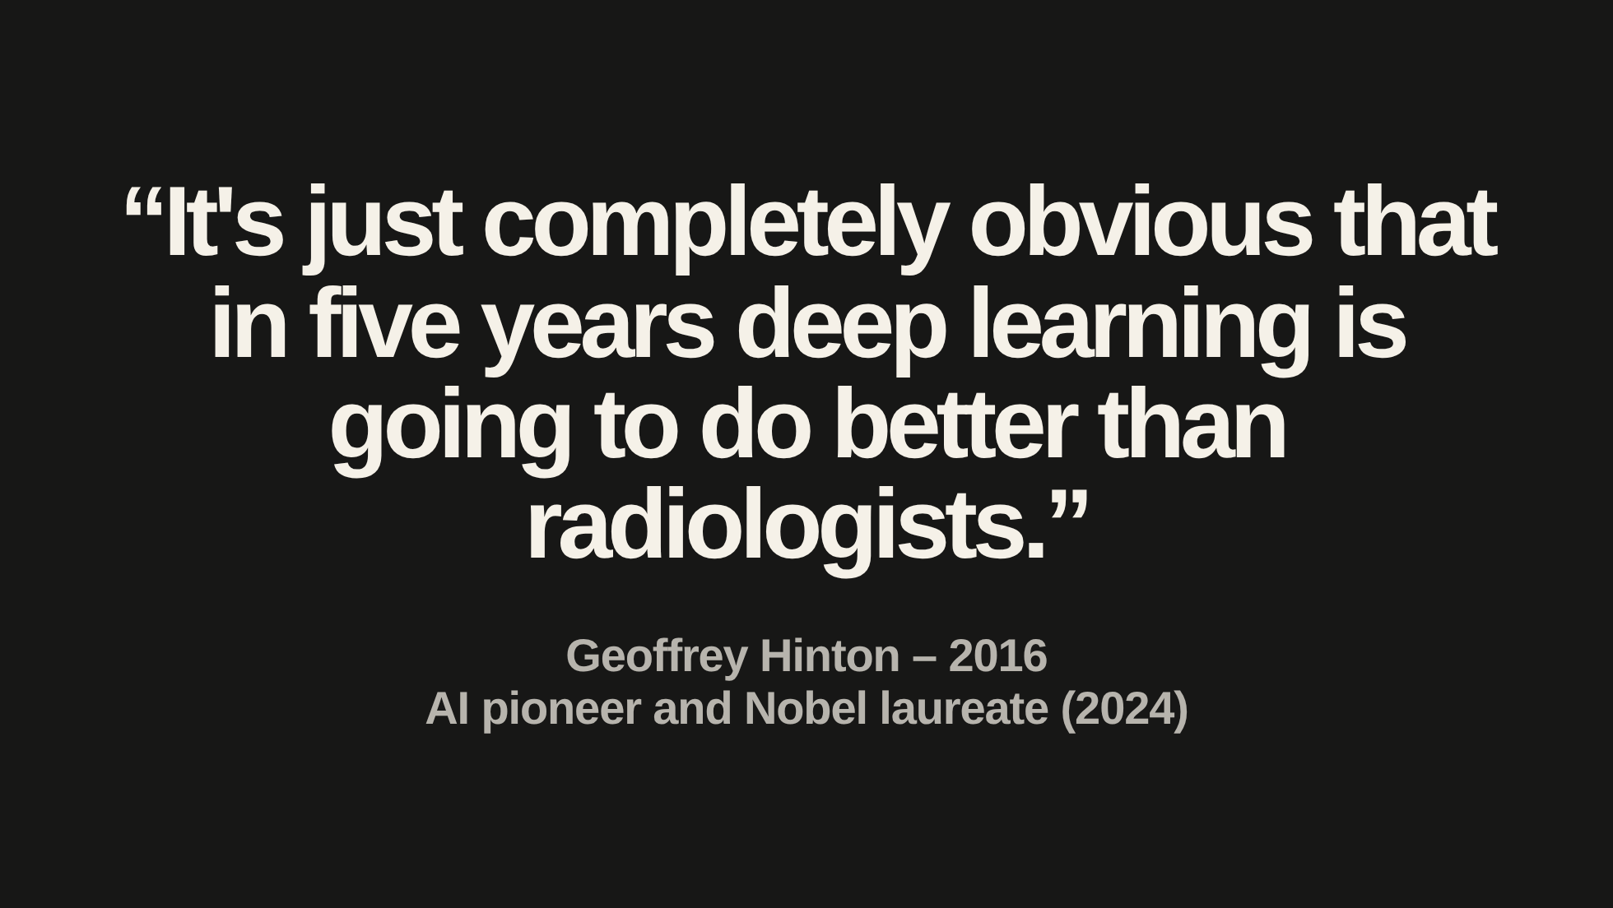
Notes:
[Sources]
- User-supplied quotation, verified against Creative Destruction Lab, “Geoff Hinton: On Radiology,” published 2016-11-24: https://www.youtube.com/watch?v=2HMPRXstSvQ
- Nobel Prize, 2024 Physics announcement. Nobel laureate is his current credential; the quotation dates from 2016: https://www.nobelprize.org/prizes/physics/2024/press-release/
[/Sources]

Slide 17
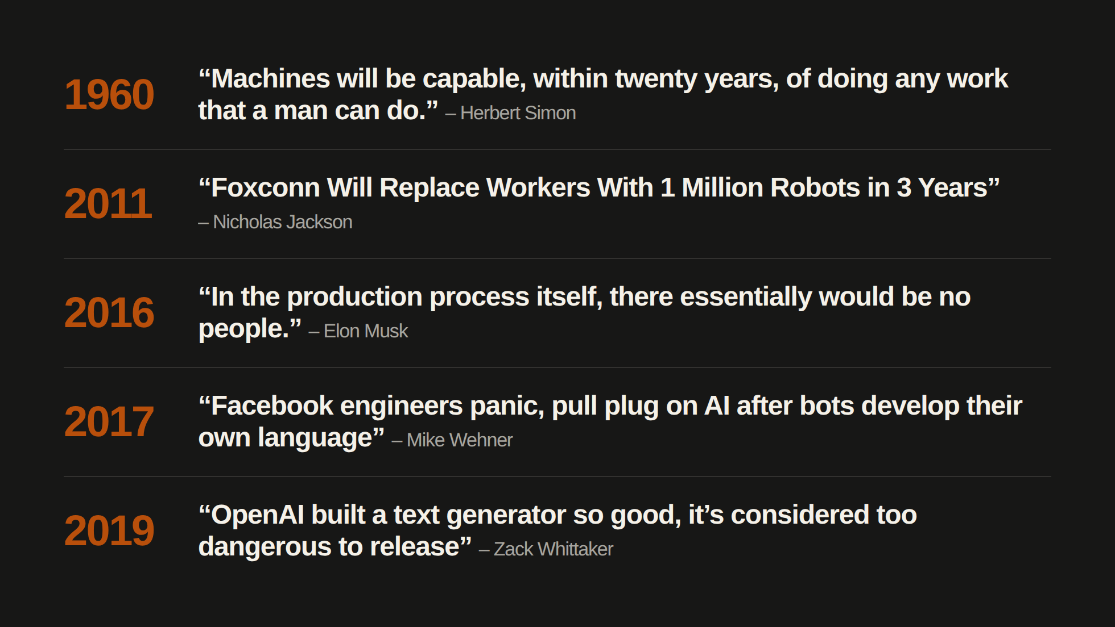
Notes:
[Sources]
- TechCrunch, Zack Whittaker, 2019-02-17. Headline quoted as published: https://techcrunch.com/2019/02/17/openai-text-generator-dangerous/
- Fox News / BGR, Mike Wehner, 2017-07-31. Historical headline quoted as published, not an endorsement of its claim that Facebook panicked: https://www.foxnews.com/tech/facebook-engineers-panic-pull-plug-on-ai-after-bots-develop-their-own-language
- Elon Musk, Tesla Q2 2016 earnings call, 2016-08-03. Transcript mirror: https://stockanalysis.com/stocks/tsla/transcripts/23973-q2-2016/ . Quotation concerns a future version of production; Musk immediately clarified that people would still maintain and upgrade machines and handle anomalies.
- The Atlantic, Nicholas Jackson, 2011-07-31. Headline quoted as published: https://www.theatlantic.com/technology/archive/2011/07/foxconn-will-replace-workers-with-1-million-robots-in-3-years/242810/
- Herbert A. Simon, The New Science of Management Decision (1960), p. 38. User-supplied quotation excerpt; original sentence begins “Technologically, as I have argued earlier”. Page-level citation and publication history: https://quoteinvestigator.com/2020/11/11/ai-can-do/
- Foxconn follow-up for speaker notes only: BusinessDay, 2015-05-05, reported about 50,000 robots, against the earlier target of one million by 2014: https://www.businessday.co.za/bd/life/gadgets-and-gear/2015-05-05-foxconns-robot-army-yet-to-prove-match-for-humans/
[/Sources]
Foxconn's target was one million robots within three years. By May 2015, a report put its automated workforce at about 50,000 robots. This was a 2015 estimate, not a count at the original 2014 deadline.

Slide 19
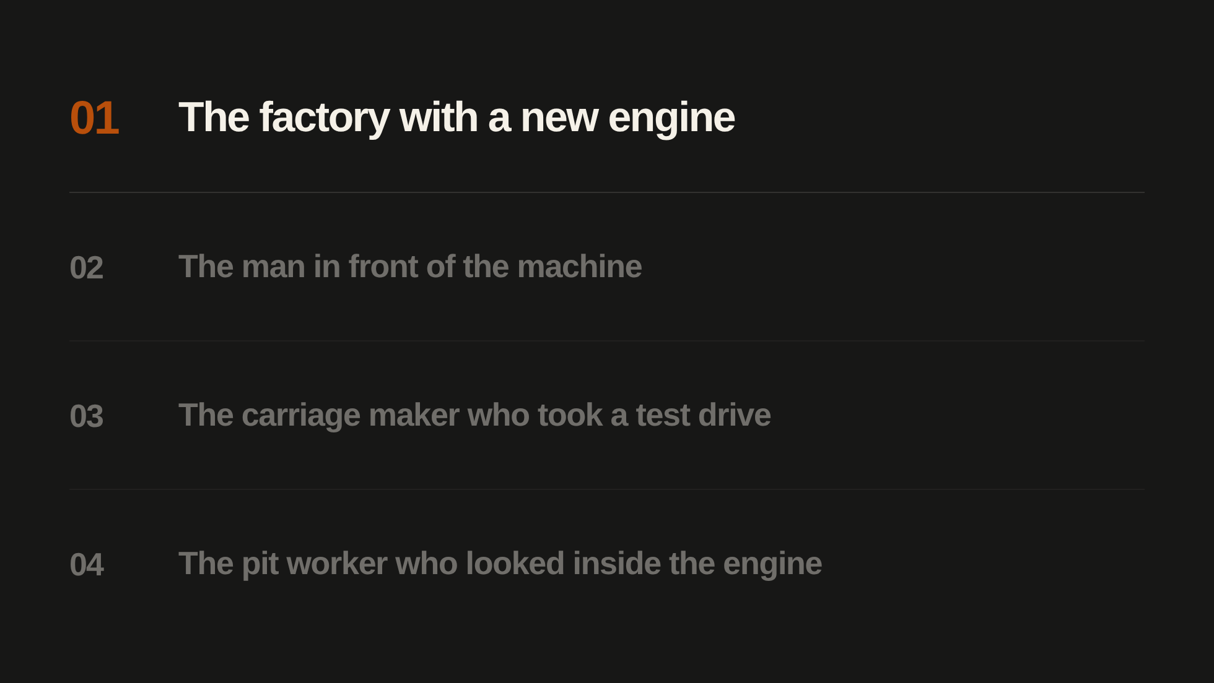
Notes:
[Sources]
- User-approved historical story titles, 2026-10-30. The current story is highlighted before it begins; all four titles remain visible.
[/Sources]

Slide 20
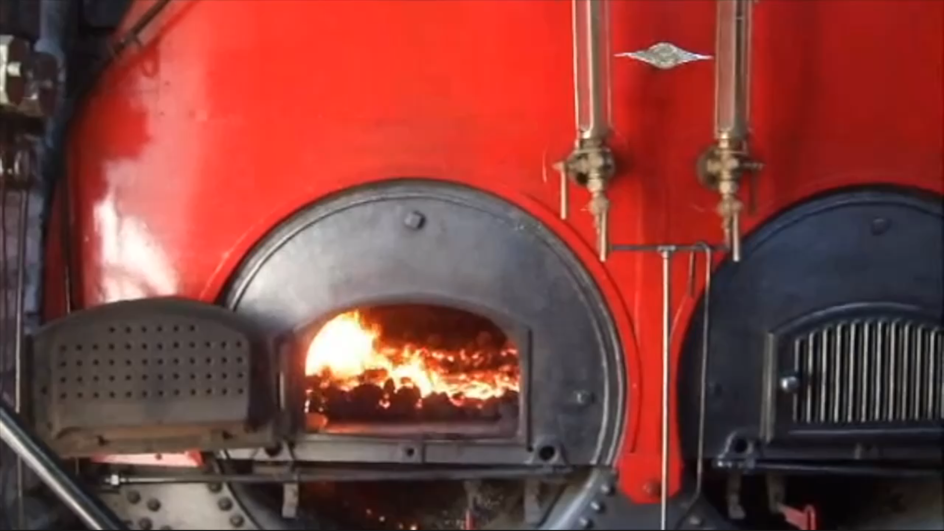
Notes:
[Sources]
- User-provided video: assets/factory/steam-factory.mp4
[/Sources]

Slide 21
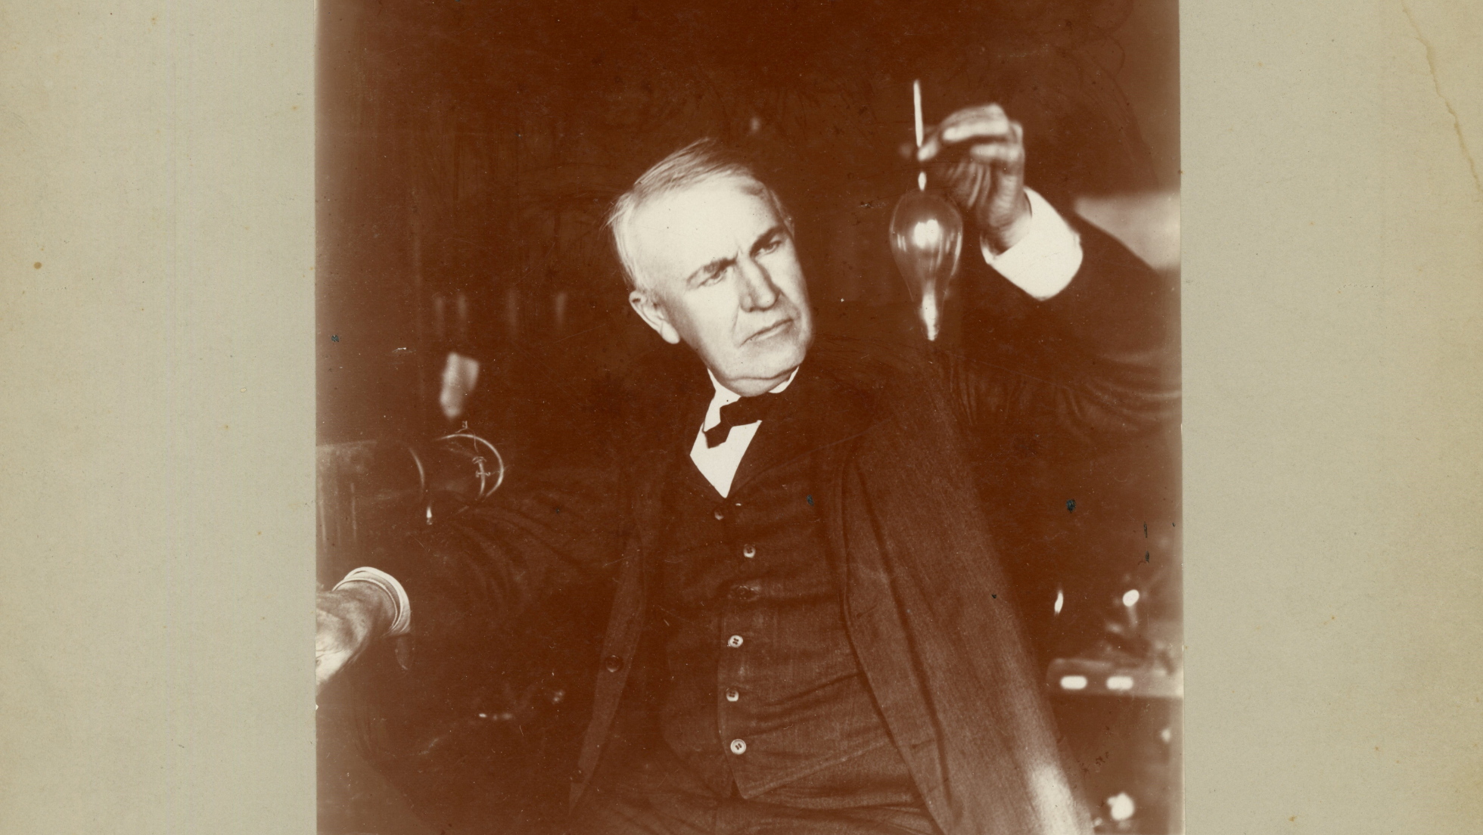
Notes:
[Sources]
- U.S. National Park Service, “Thomas Edison holding bulb or test tube” (1905), public domain: https://npgallery.nps.gov/AssetDetail/49d152238b9944e280370f2672d02257
[/Sources]

Slide 22
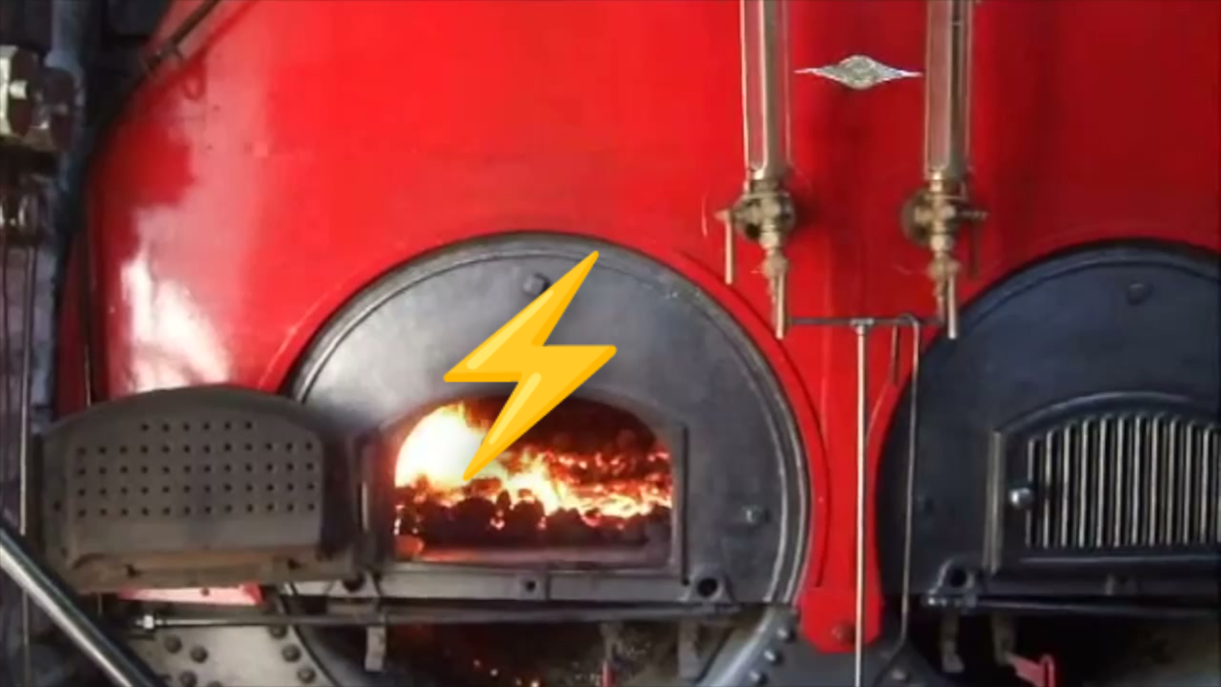
Notes:
[Sources]
- Opening frame extracted from the user-provided video: assets/factory/steam-factory.mp4
[/Sources]

Slide 23
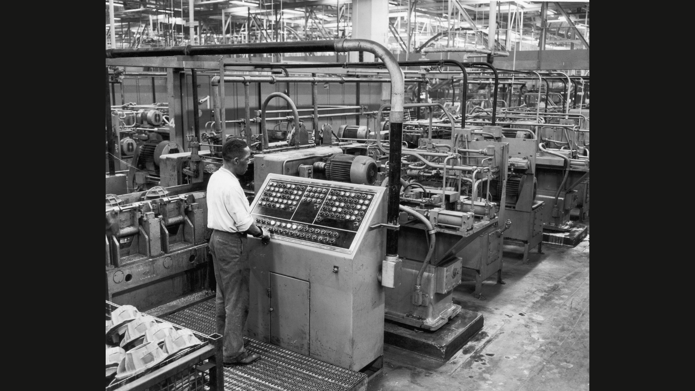
Notes:
[Sources]
- User-provided image: assets/factory/factory-control-panel-user-provided.png
[/Sources]

Slide 24
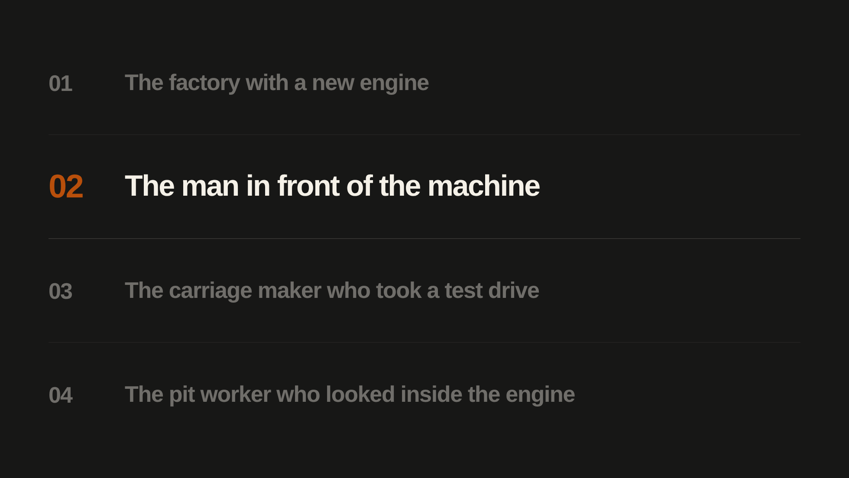
Notes:
[Sources]
- User-approved historical story titles, 2026-10-30. The current story is highlighted before it begins; all four titles remain visible.
[/Sources]

Slide 25
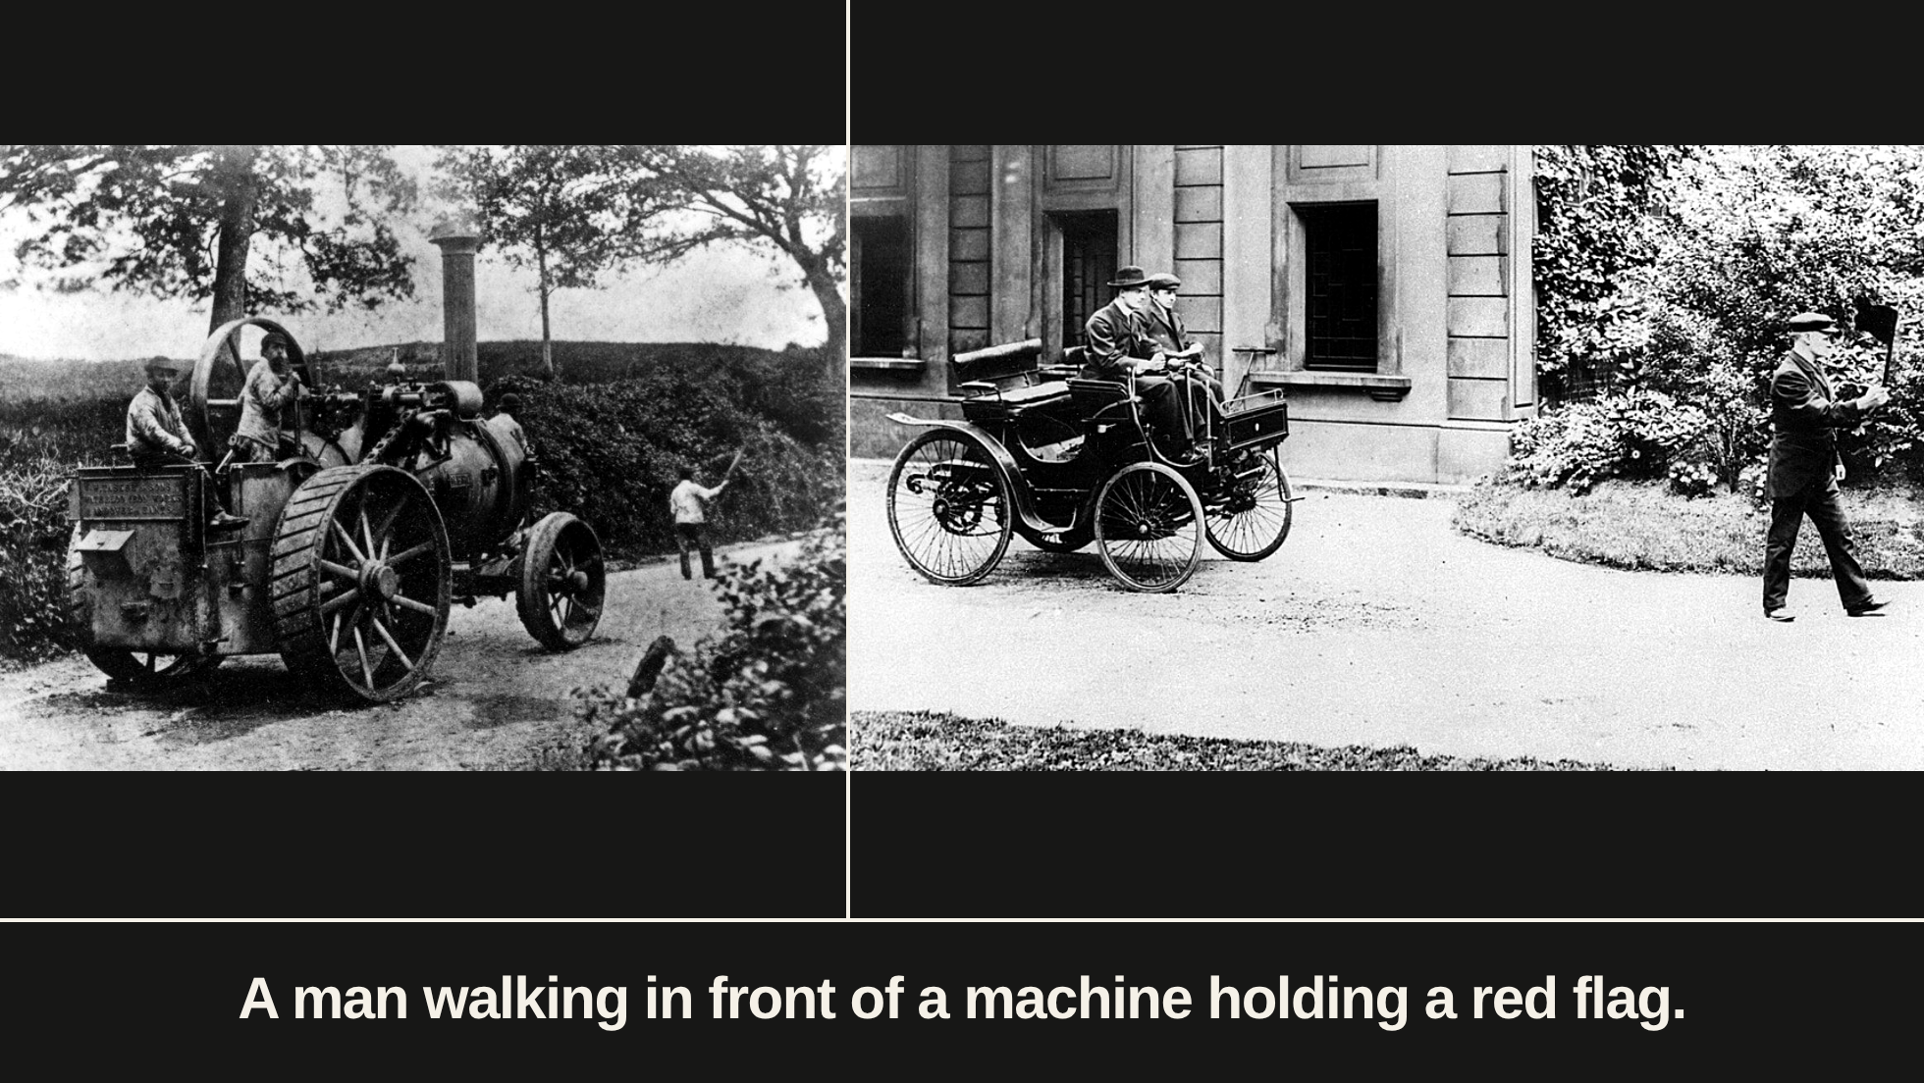
Notes:
[Sources]
- User-provided image: assets/red-flag/red_flag_1.jpg
- User-provided image: assets/red-flag/red_flag_2.jpg
[/Sources]

Slide 26
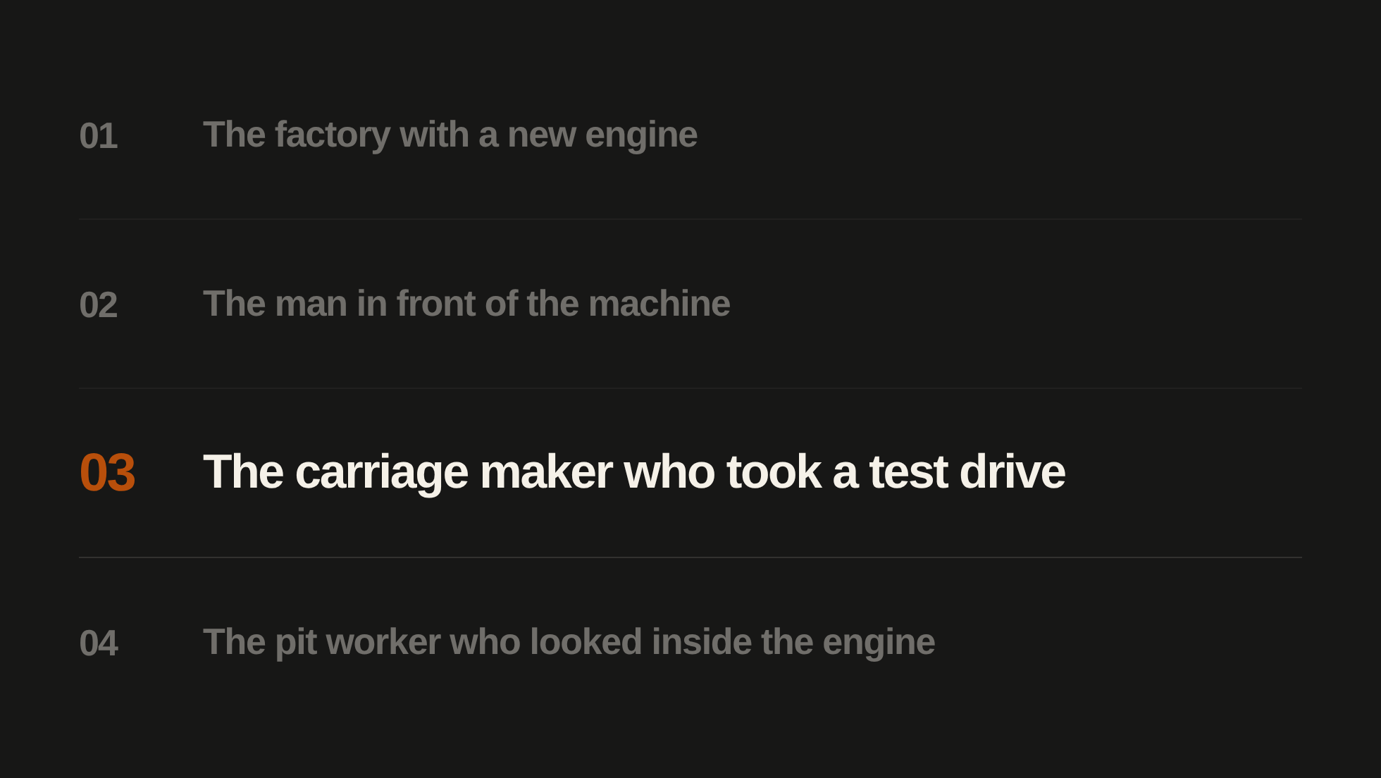
Notes:
[Sources]
- User-approved historical story titles, 2026-10-30. The current story is highlighted before it begins; all four titles remain visible.
[/Sources]

Slide 27
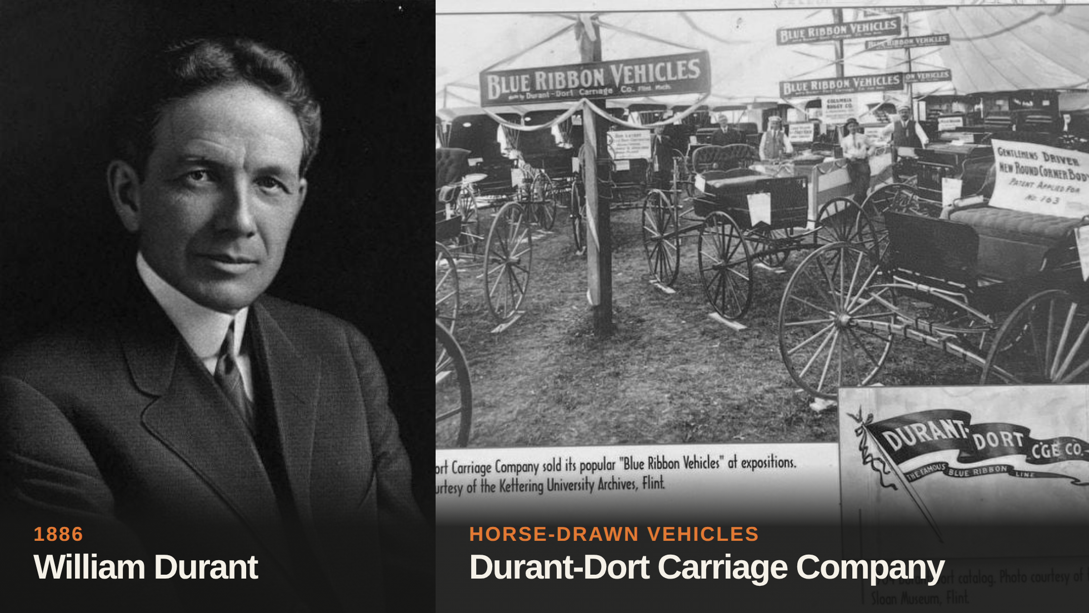
Notes:
[Sources]
- User-provided image: assets/durant/durant_portrait.png
- User-provided image: assets/durant/durant_carriage_company.png
- General Motors, “Story of GM Founder, William Durant”: https://www.gm.com/heritage
[/Sources]

Slide 28
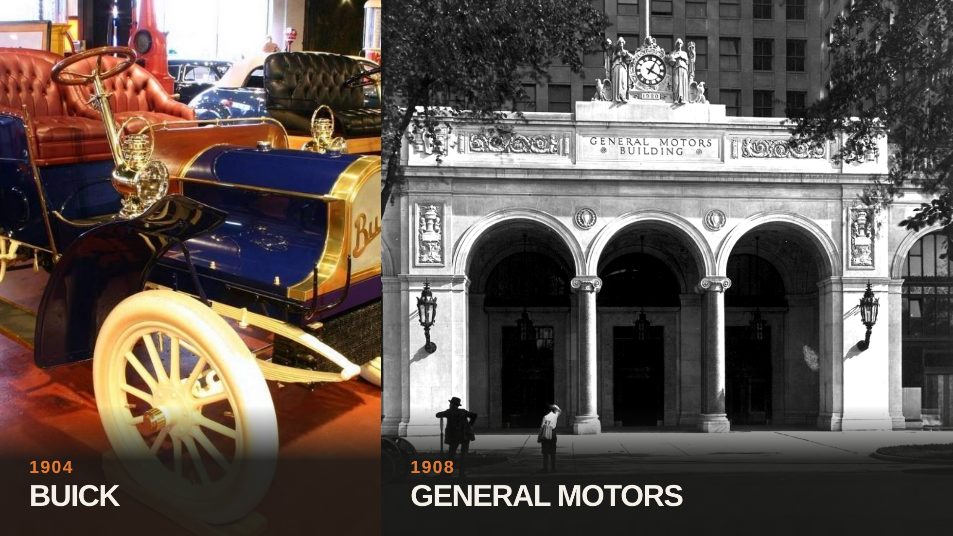
Notes:
[Sources]
- User-provided image: assets/durant/buick.jpg
- User-provided image: assets/durant/gm.png
- General Motors, “Story of GM Founder, William Durant”: https://www.gm.com/heritage
[/Sources]

Slide 29
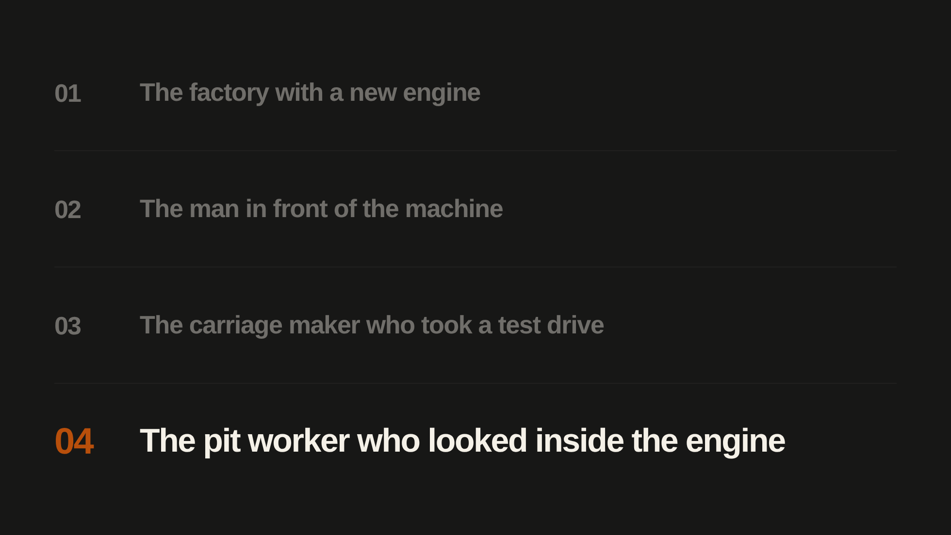
Notes:
[Sources]
- User-approved historical story titles, 2026-10-30. The current story is highlighted before it begins; all four titles remain visible.
[/Sources]

Slide 30
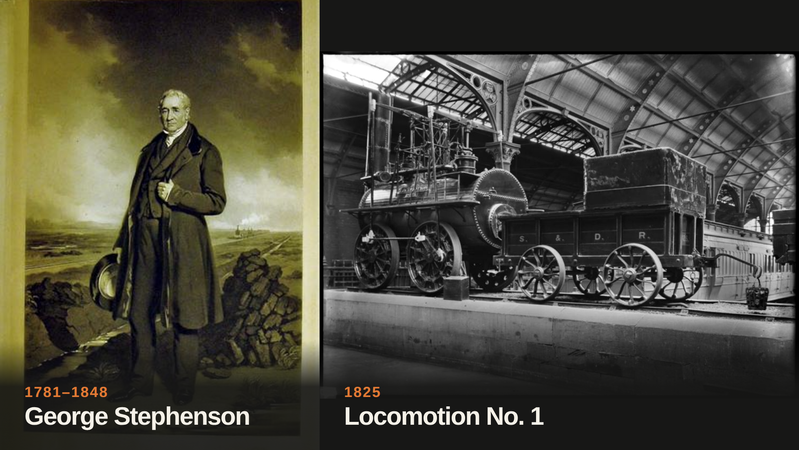
Notes:
[Sources]
- John Lucas (artist) and Thomas Lewis Atkinson (engraver), “Portrait of George Stephenson standing on Chat Moss” (1849), Science Museum Group Collection, object 1978-2021. CC BY-NC-SA 4.0: https://collection.sciencemuseumgroup.org.uk/objects/co420171/engraving-portrait-of-george-stephenson-standing-on-chat-moss-by-john-lucas-1849
- Historic England Archive, “The S&DR's Locomotion No.1 displayed as a historical artifact at Darlington railway station in the early 20th century,” image reference BB057004. © Historic England Archive; reproduction permission required: https://historicengland.org.uk/whats-new/research/a-brief-overview-of-the-stockton-and-darlington-railway/
- Historic England Archive image-use policy: https://historicengland.org.uk/images-books/archive/policies/using-images/
[/Sources]

Slide 31
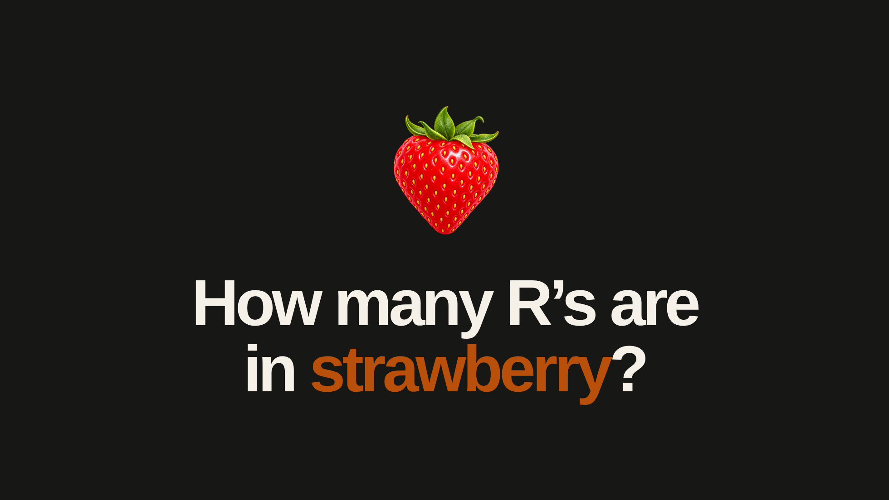
Notes:
[Sources]
- User-corrected question, 2026-10-30: “How many R’s are in strawberry?”
- Strawberry icon generated with OpenAI's built-in image-generation tool on 2026-10-30, using the existing raspberry icon as the style/composition reference; transparent PNG, no third-party source asset. A cleanup edit removed a stray edge speck.
- Edit prompt: Replace the raspberry with a ripe strawberry, retaining the reference image's polished dimensional fruit-emoji illustration style, bold red fruit, fresh green leafy crown, centered single-object composition and transparent background. Give the strawberry a heart-shaped berry tapering to a soft point, clearly visible small yellow seeds, and a short green leafy crown. One fruit only, no text, extra fruit, plate, border, badge, or watermark.
- Original style-reference asset retained unchanged at assets/ai-learning/raspberry-icon.png; generated with OpenAI image generation on 2026-10-27 as a raspberry. Its original prompt specified “A raspberry, not a strawberry.”
[/Sources]

Slide 32
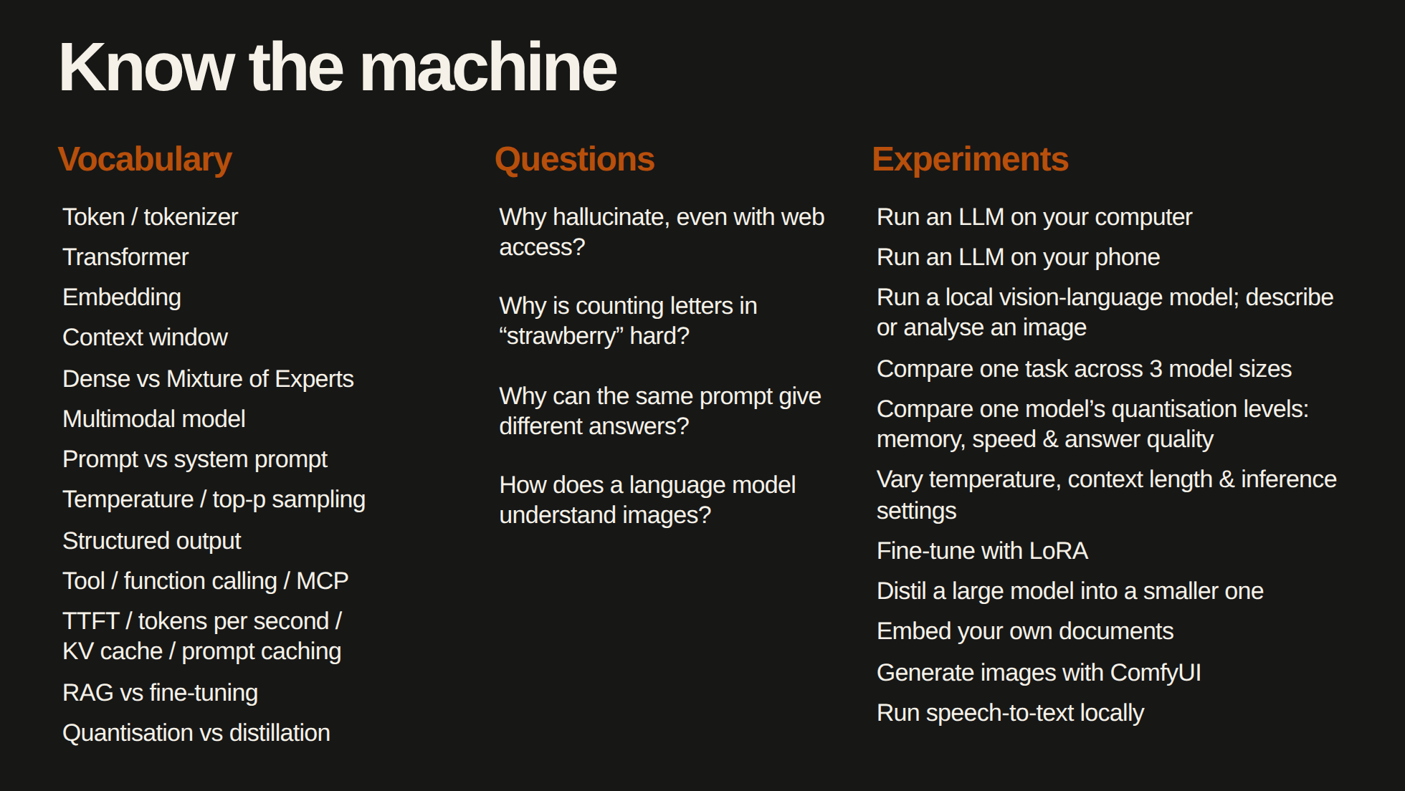
Notes:
[Sources]
- User-provided vocabulary, questions and starter checklist, shortened for this slide; all 13 vocabulary groups, 4 questions and 11 experiments retained.
[/Sources]

Slide 33
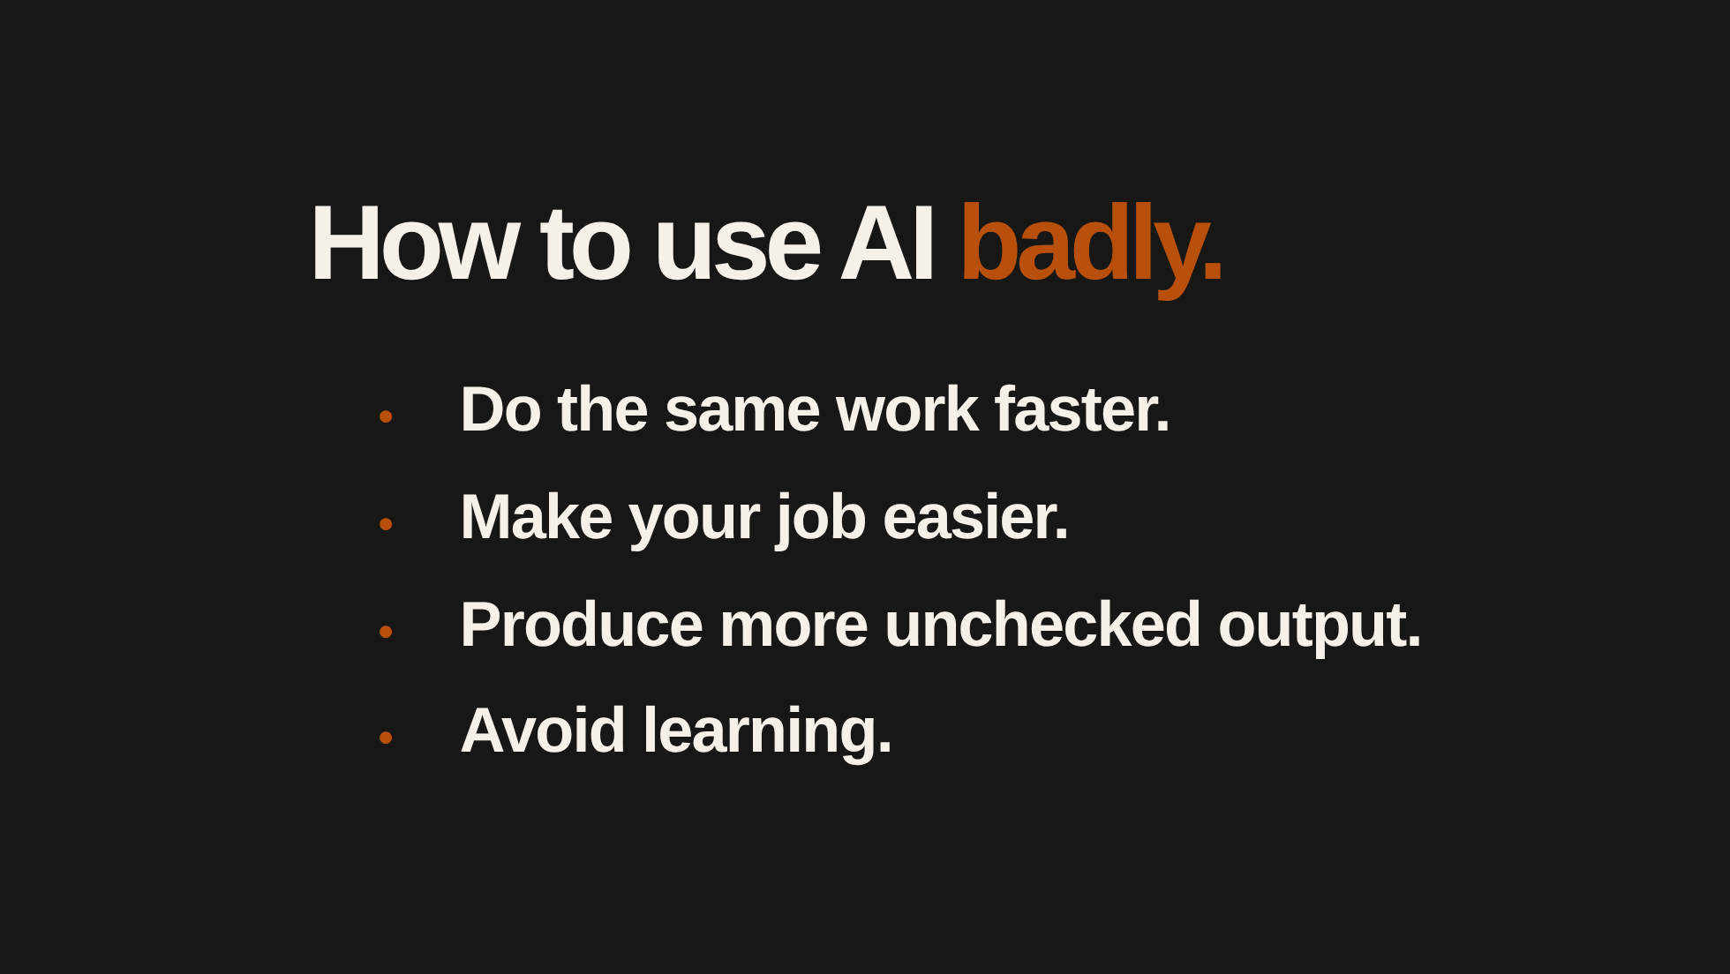
Notes:
[Sources]
- Author's four criticisms from draft.md, “Using AI for the wrong things,” summarised for this slide.
[/Sources]
Are you doing your work faster? Everyone is doing it. It's just a requirement at that point, like knowing how to use Figma.
Is it making your job easier? You're reducing your own market value. Now someone cheaper can do it.
You're producing more work. Who is reviewing it? You're creating more work without delivering more value.
And lastly, my favourite one. People who use AI to avoid learning. You get results without understanding how they work. There is absolutely zero value in hiring you because anyone can do that.

Slide 34
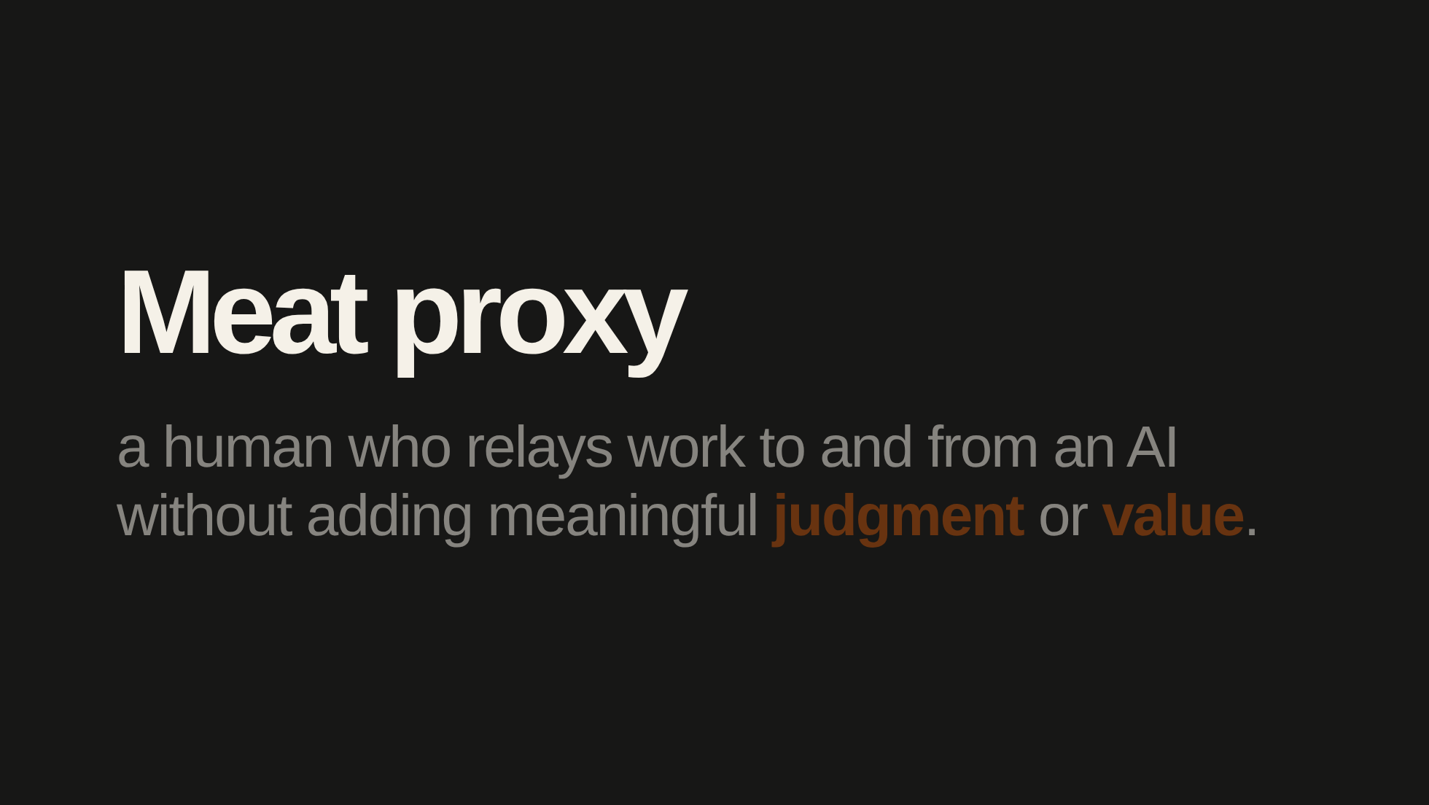

Slide 35
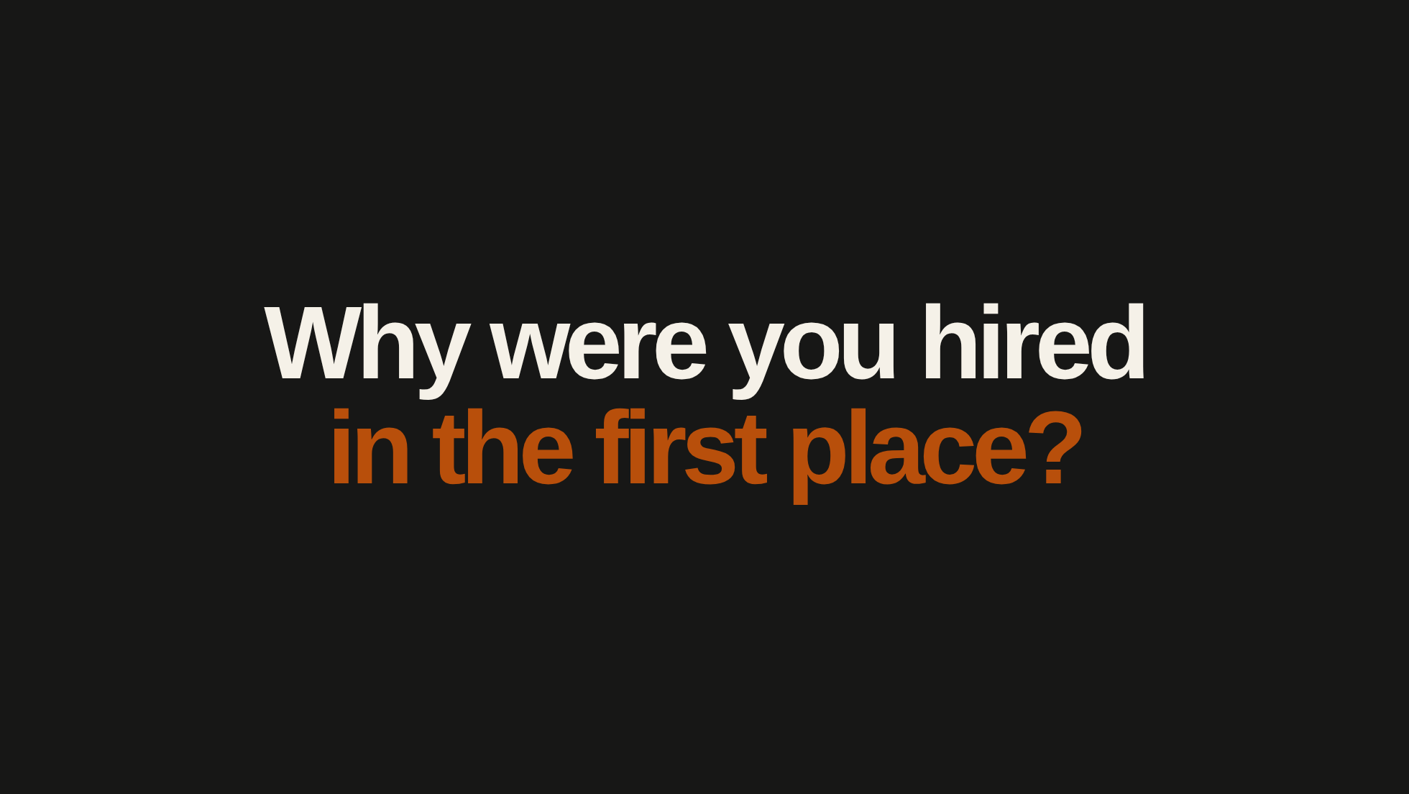
Notes:
[Sources]
- Author's question from draft.md, “Why were you hired in the first place?”
[/Sources]
Before we talk about AI replacing your job, let's start with a simple question.
Why is your company paying you so much money?

Slide 36
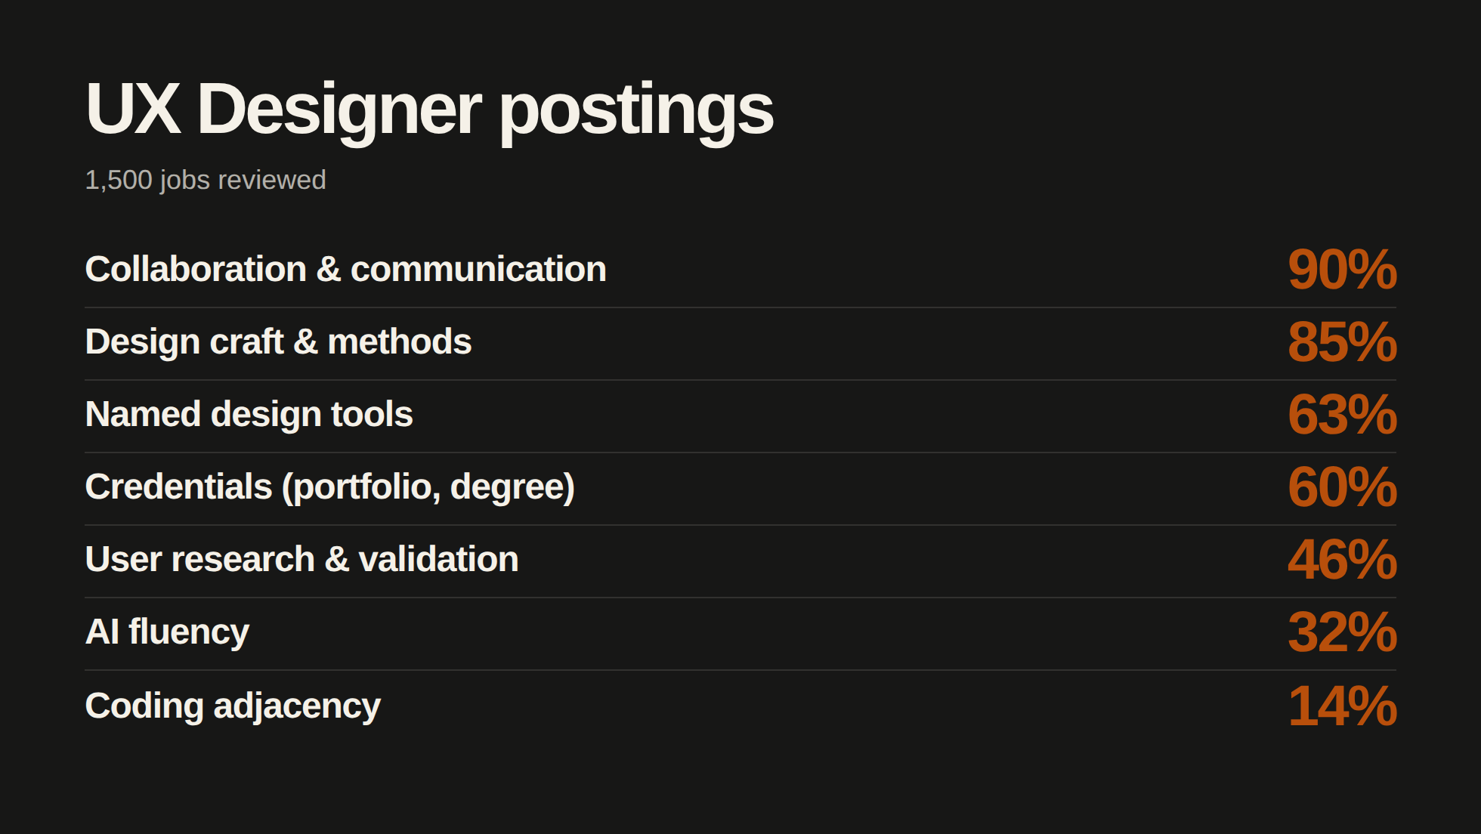
Notes:
[Sources]
- User-provided category labels, percentages and sample size: 1,500 UX Designer postings reviewed.
[/Sources]

Slide 37
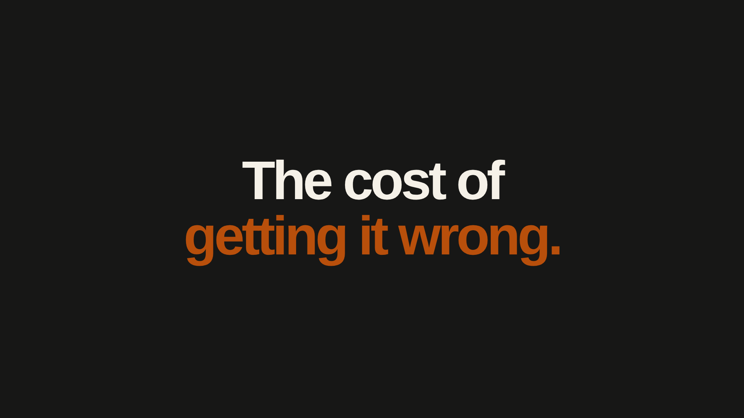
Notes:
[Sources]
- Illustrative software-team scenario from draft.md, “The cost of getting is wrong.” This is a hypothetical progression, not measured delivery-time data.
[/Sources]
Let's take an average team building a software product.
At first, everything moves quickly. Feature gets built and shipped on time. Everyone's happy.
But nobody checks how the changes affect the rest of the product and bad decisions keep pilling on. For a while, it doesn't matter because the team keeps meeting its deadlines.
Then things start breaking. Fixes are getting increasingly complicated.
Customers complain. The next release gets postponed. The team spends another week fixing the previous release.
After a while, features that used to take days take weeks, then months and eventually nothing gets shipped. Everyone is scared to touch anything because they don't know what will break.
The company is paying an entire team to deal with the consequences of its previous bad decisions instead of shipping software to customers.

Slide 38
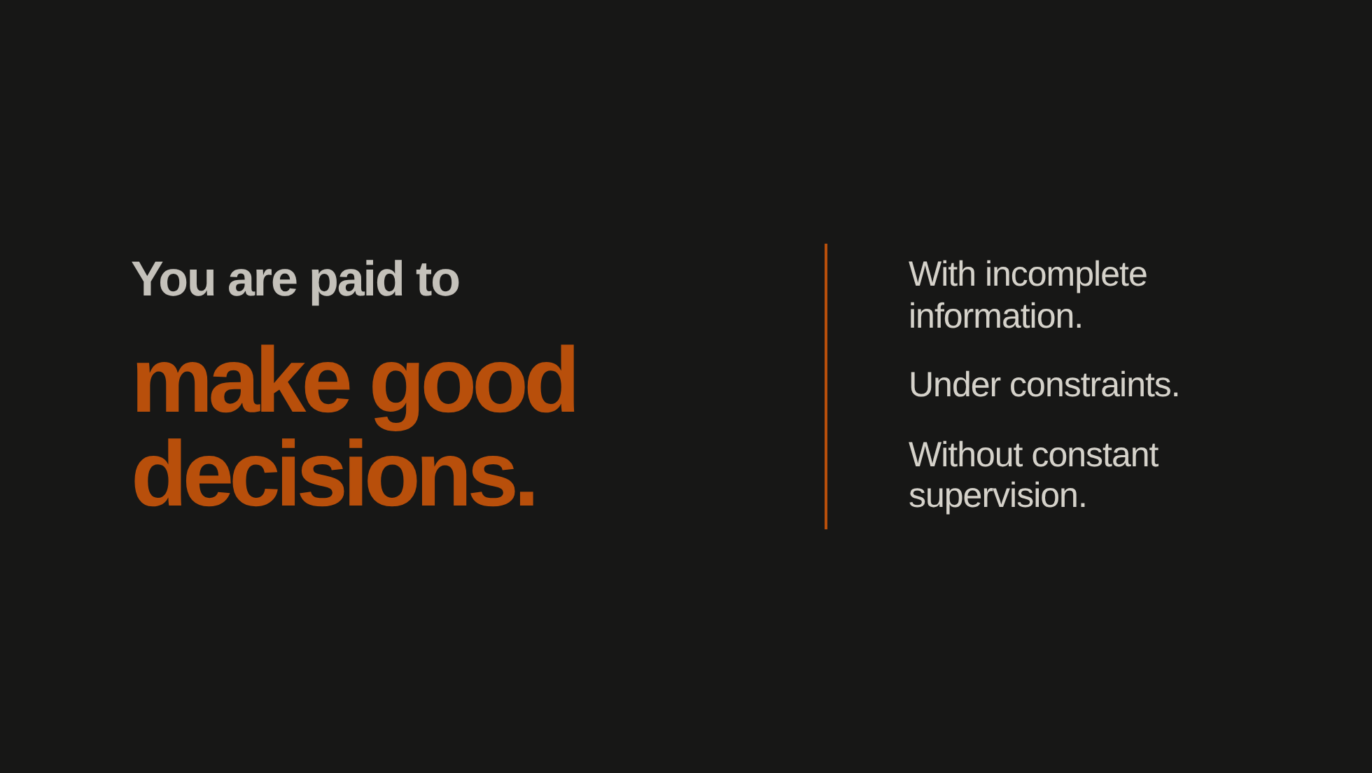
Notes:
[Sources]
- Author's central argument from draft.md, “You are paid to make good decisions.”
[/Sources]
There used to be a physical limit to how many bad decisions someone could make. This is no longer the case with AI.
It doesn't matter if AI can "do your job". More than even, there is one reason why you are getting paid.
You are paid to consistently make good decisions with incomplete information, under constraints and without constant supervision.
That includes knowing how to ship useful work on time without turning the product into something that breaks whenever someone changes it.

Slide 39
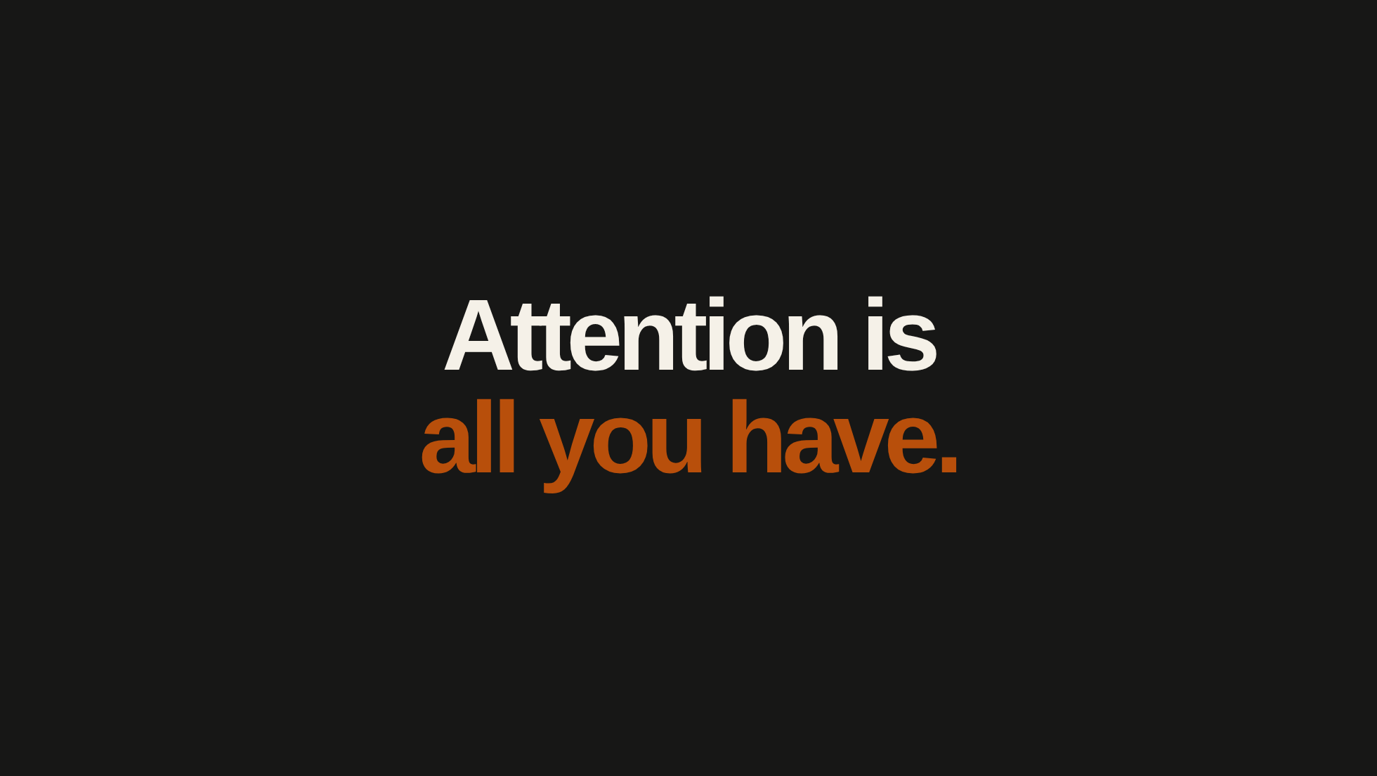
Notes:
[Sources]
- Author's framing from draft.md, “Attention is all you need.”
[/Sources]
If you're paid to think and make good decisions, your ability to process information and make decisions is limited. You only have so much attention and mental energy each day.

Slide 40
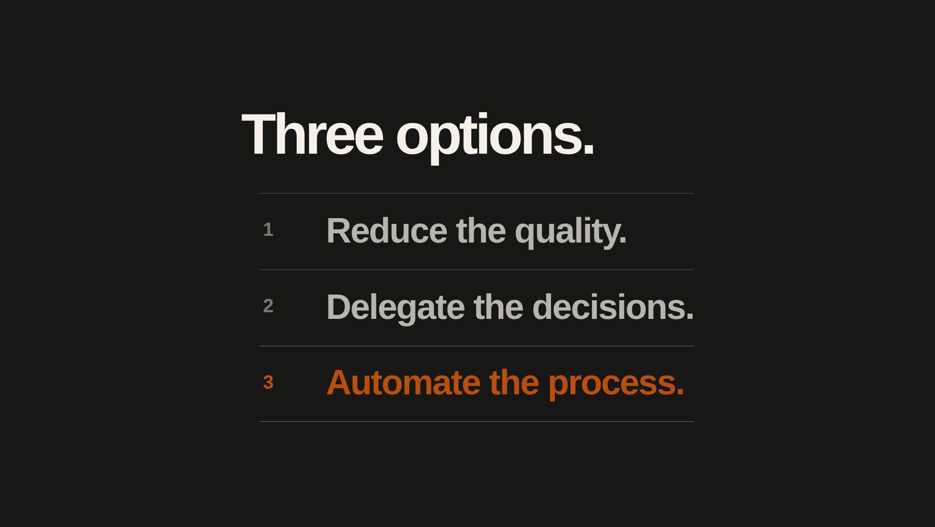
Notes:
[Sources]
- Author's three-option framing from draft.md, “Attention is all you need.”
[/Sources]
If you want to achieve more, you have a few options:
1. Reduce the quality. Make decisions faster, spend less time thinking about the consequences and accept more mistakes.
2. Delegate decisions to AI. But making good decisions is what you're paid for. If AI can do that without your judgment, why does your employer need you?
3. Automate the entire process.

Slide 41
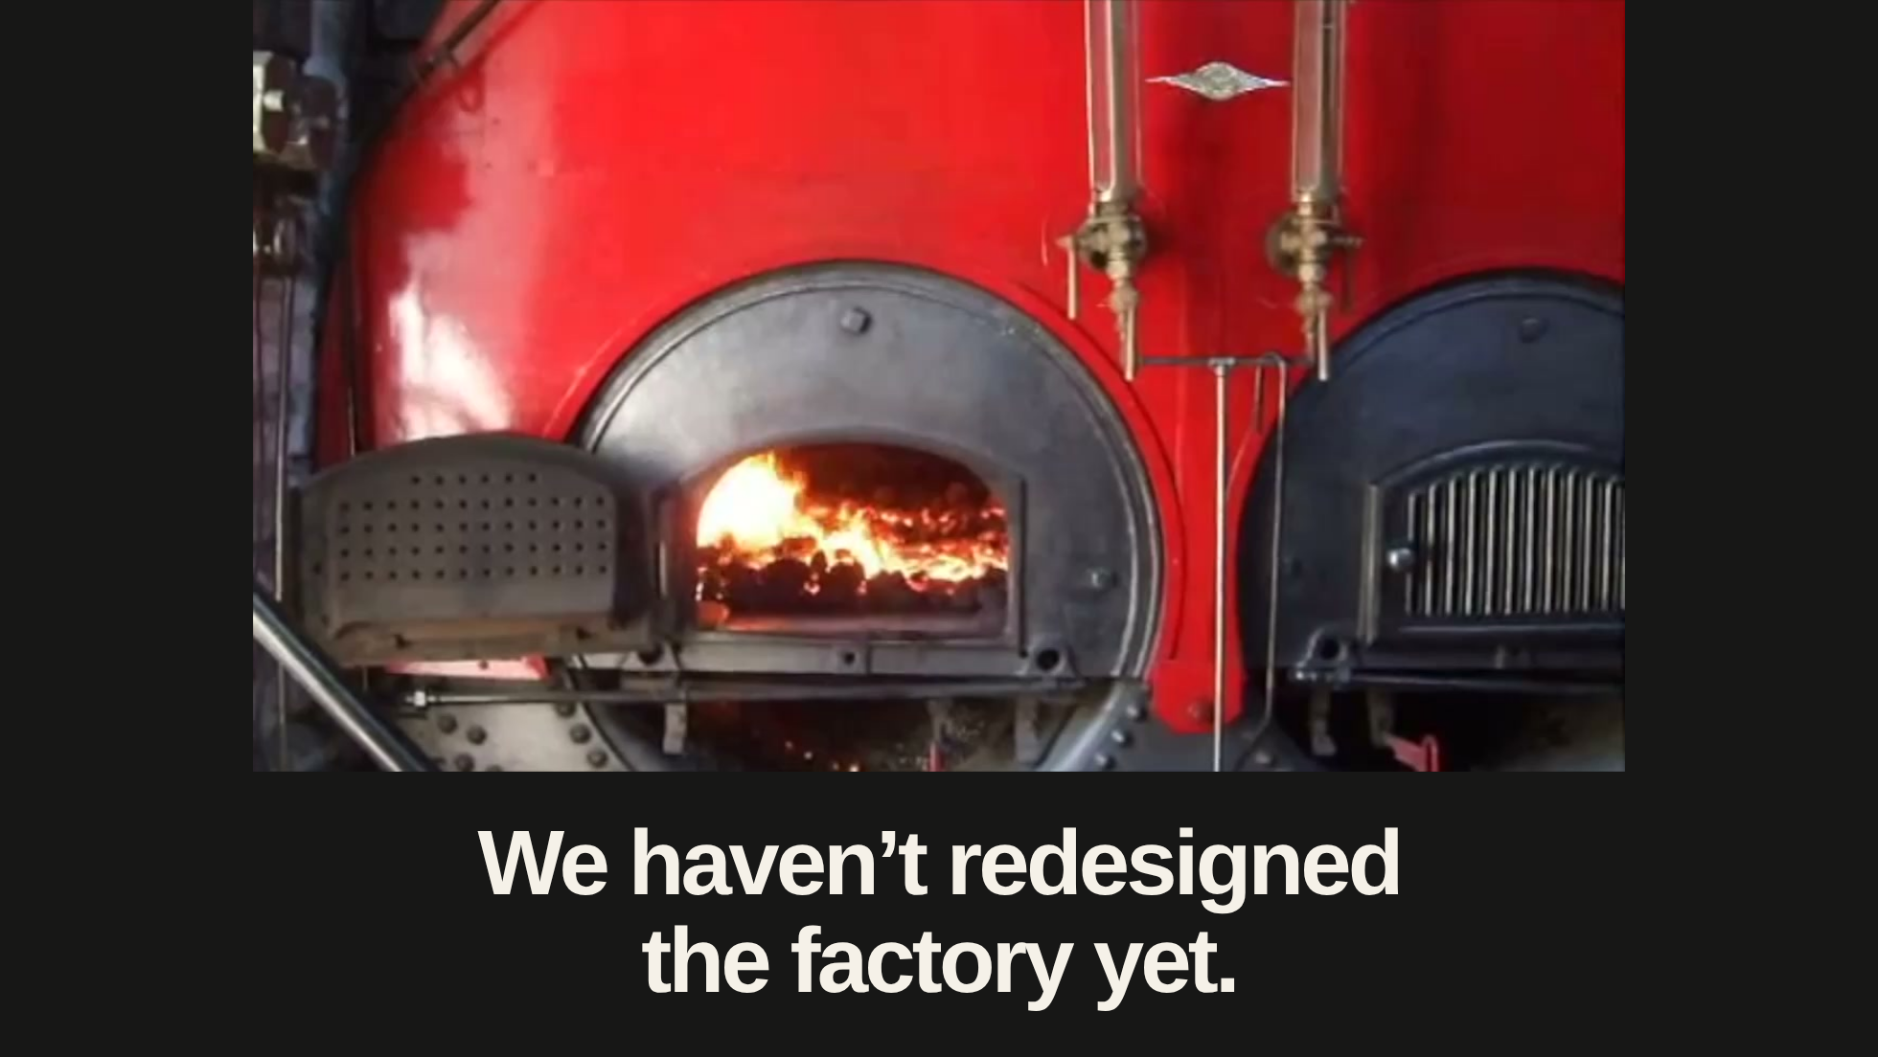
Notes:
[Sources]
- Author's factory callback from draft.md, “We haven't redesigned the factory yet.”
- Still extracted from the user-provided video: assets/factory/steam-factory.mp4. Used as a metaphor for the existing process.
[/Sources]
Someone investigates a customer problem and writes a ticket. A designer proposes a solution. An engineer implements it. Someone reviews the change, someone tests it and eventually it reaches customers.
Give everyone an AI tool and each person can complete their part faster.
We've been given the power to automate so much more. Somehow we're using it to do exactly the same work a little faster.
Why are we keeping the same process?

Slide 42
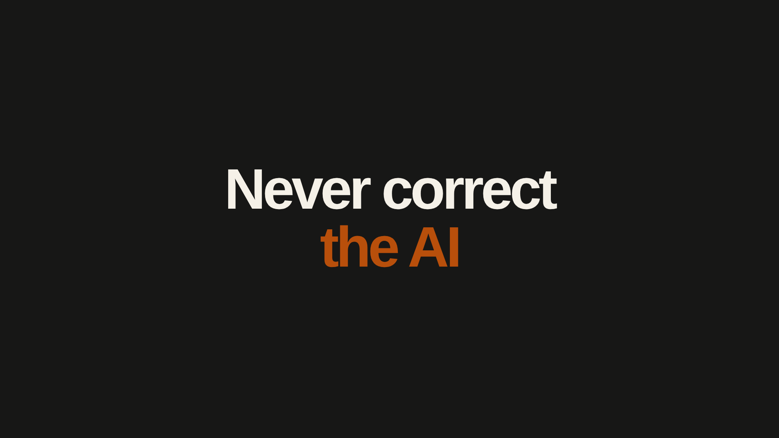
Notes:
[Sources]
- User-provided slide wording: “Never correct the AI”.
[/Sources]

Slide 43
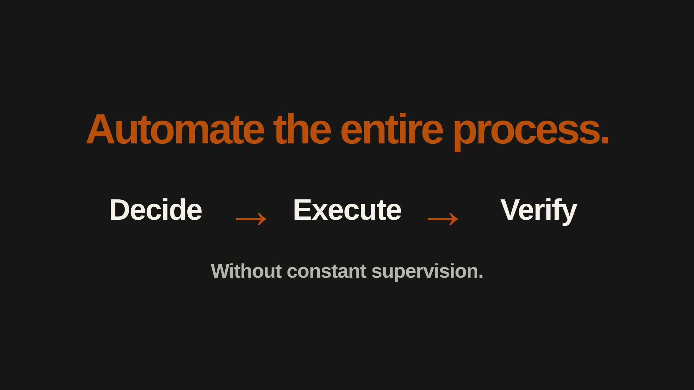
Notes:
[Sources]
- Author's proposed approach from draft.md, “Attention is all you need.” This is the desired system behaviour, not a claim that every process can currently be automated.
[/Sources]
Build systems that can make decisions, execute them and verify the results without constant supervision. Then use the capacity you've gained to solve more problems.
Number 3 is the only correct answer. It is time to tackle the problems we never had the time, money or resources to solve.

Slide 44
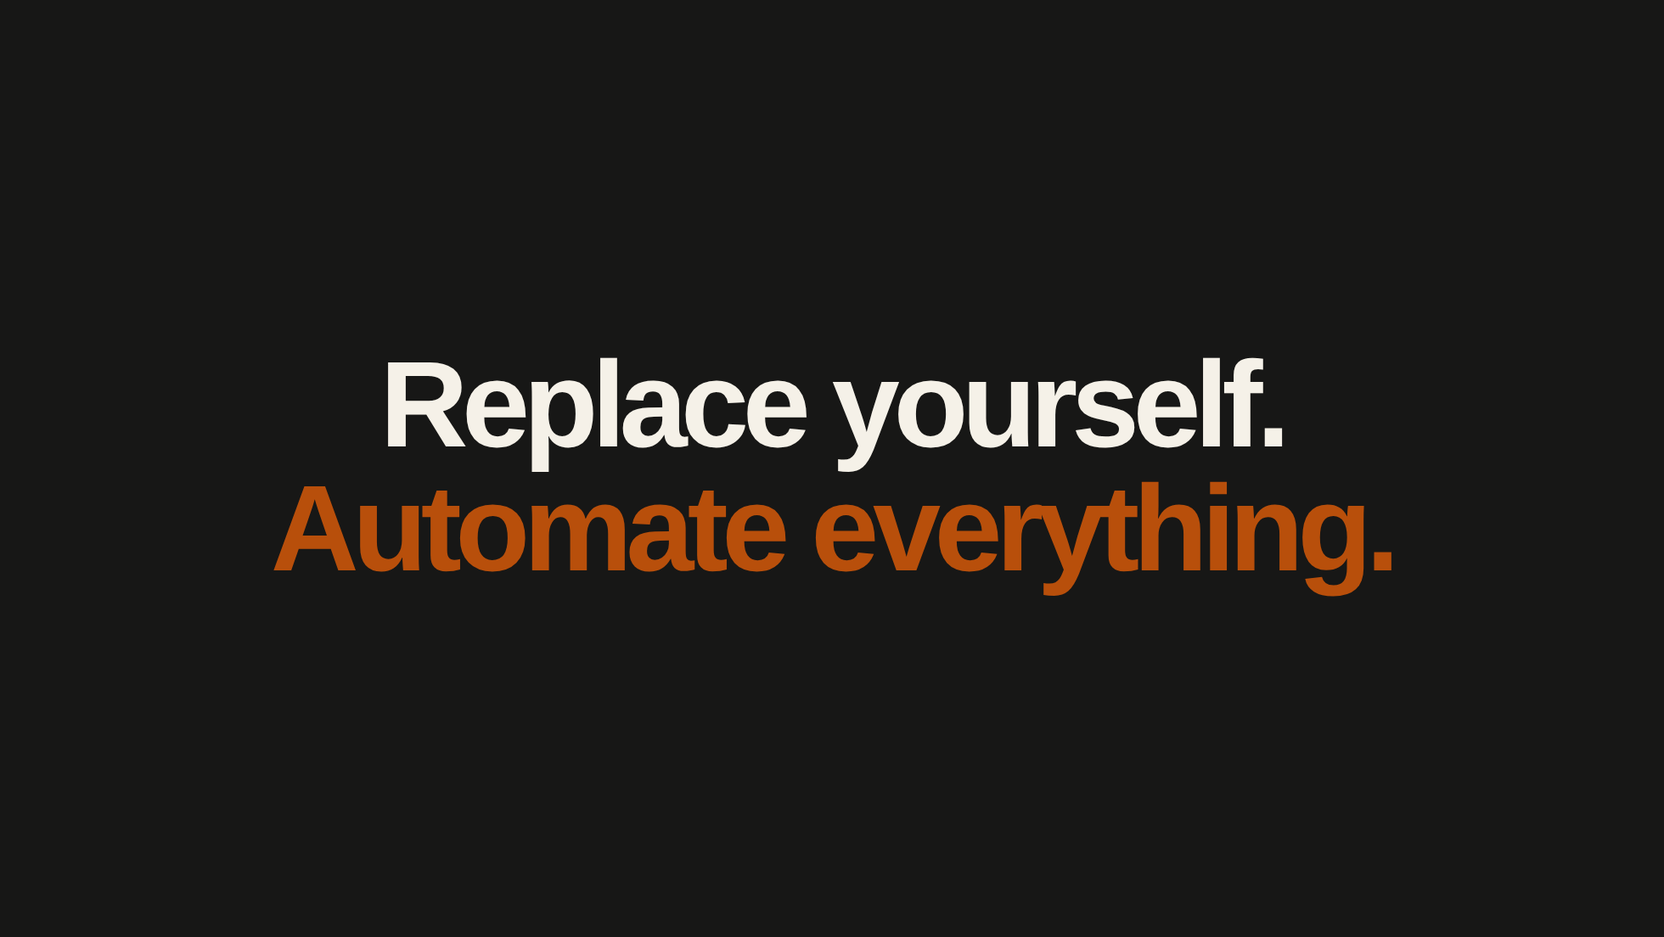
Notes:
[Sources]
- User-provided closing message: “Replace yourself. Automate everything.”
[/Sources]

Slide 45
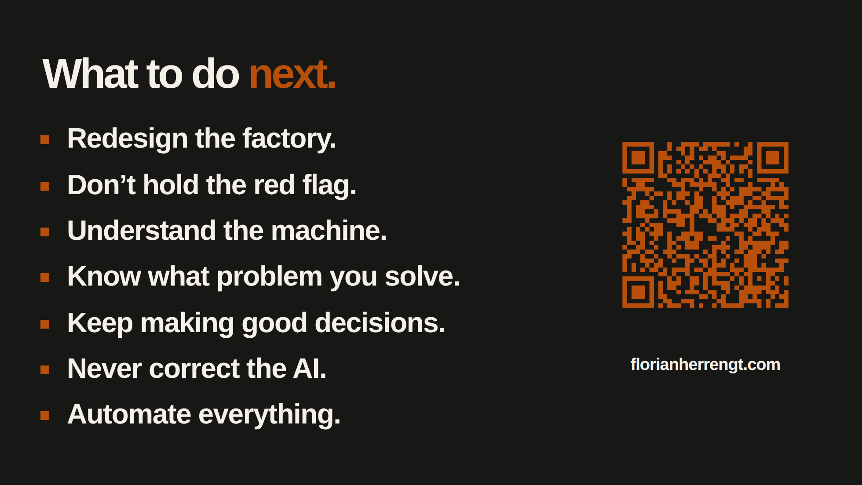
Notes:
[Sources]
- User-requested comparison with the published original recap, retaining its wording, list order and composition: https://florianherrengt.github.io/ux-brighton-2026/45
- The first four points summarise the historical stories in draft.md; the remaining three retain the author's practical advice.
- QR code generated locally with macOS Core Image; reuses the current orange asset, user-requested website URL and Google Analytics tags. No external artwork.
[/Sources]

